Slide 1
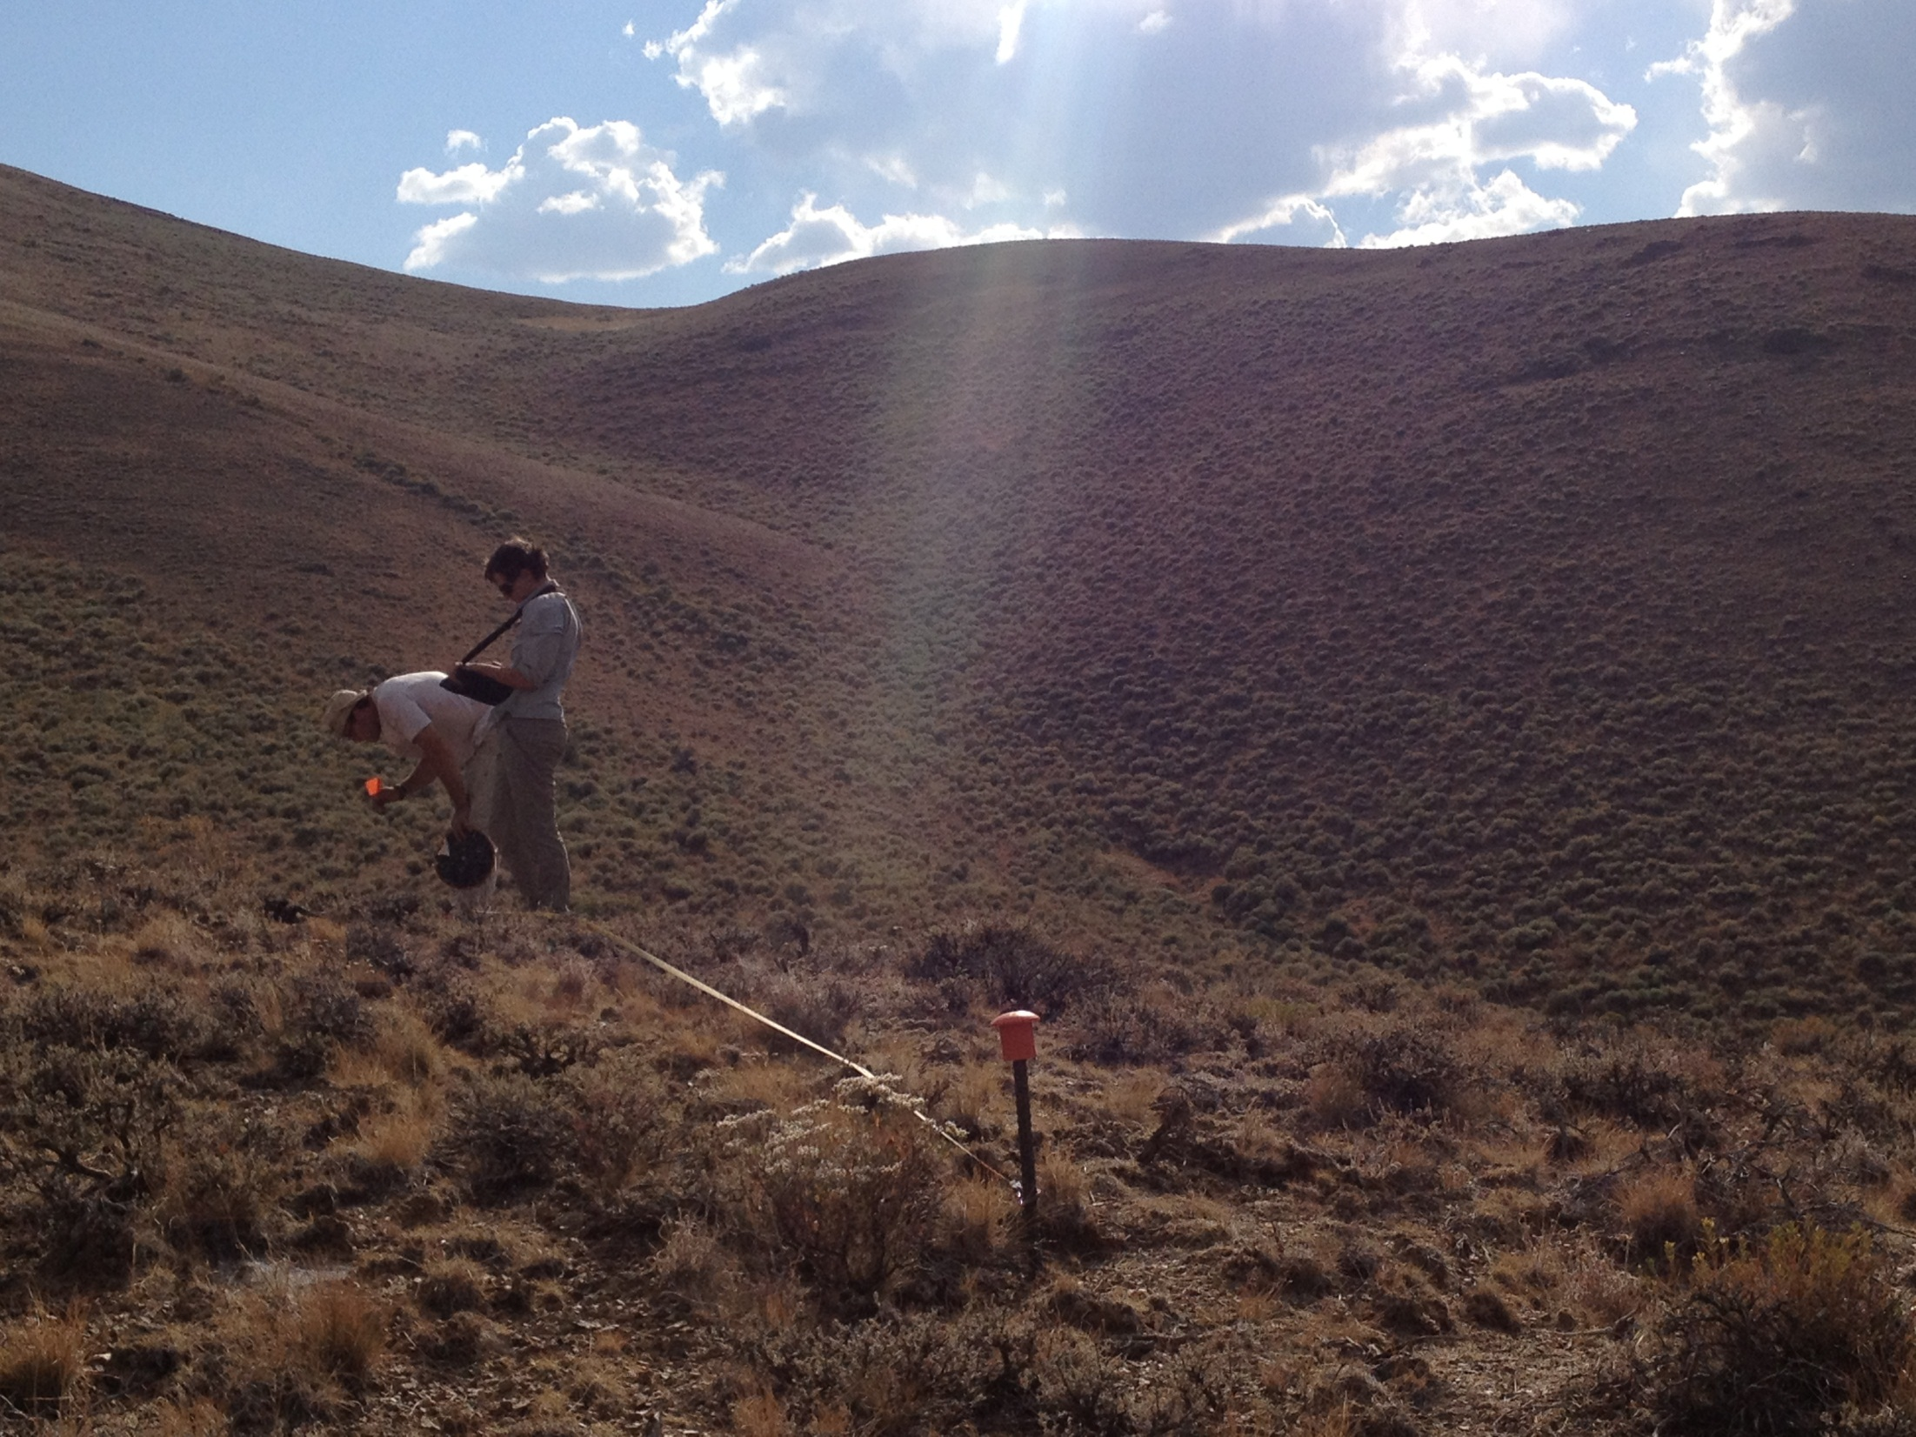

Monitoring for Adaptive Management
BLM’s National Assessment, Inventory, and Monitoring Strategy
Emily Kachergis
Landscape Ecologist
BLM National Operations Center
Denver, CO

Slide 2
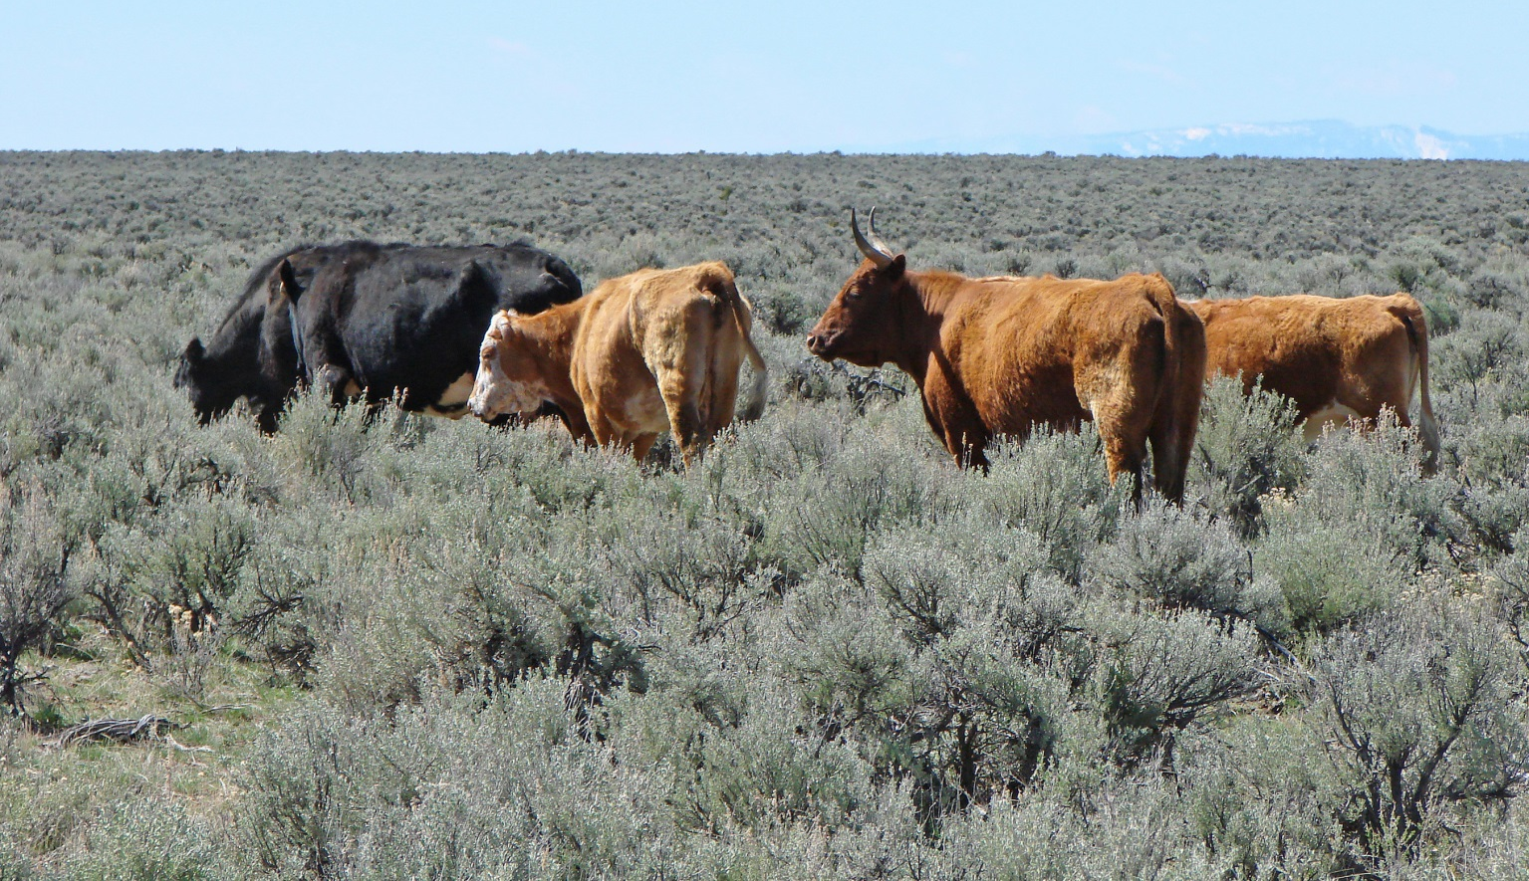

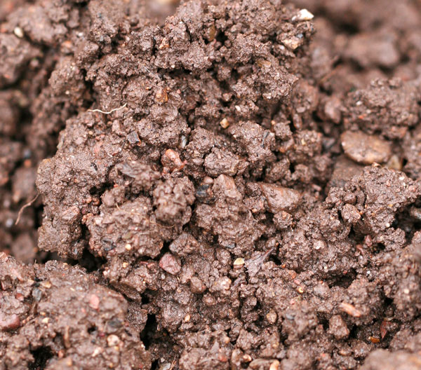
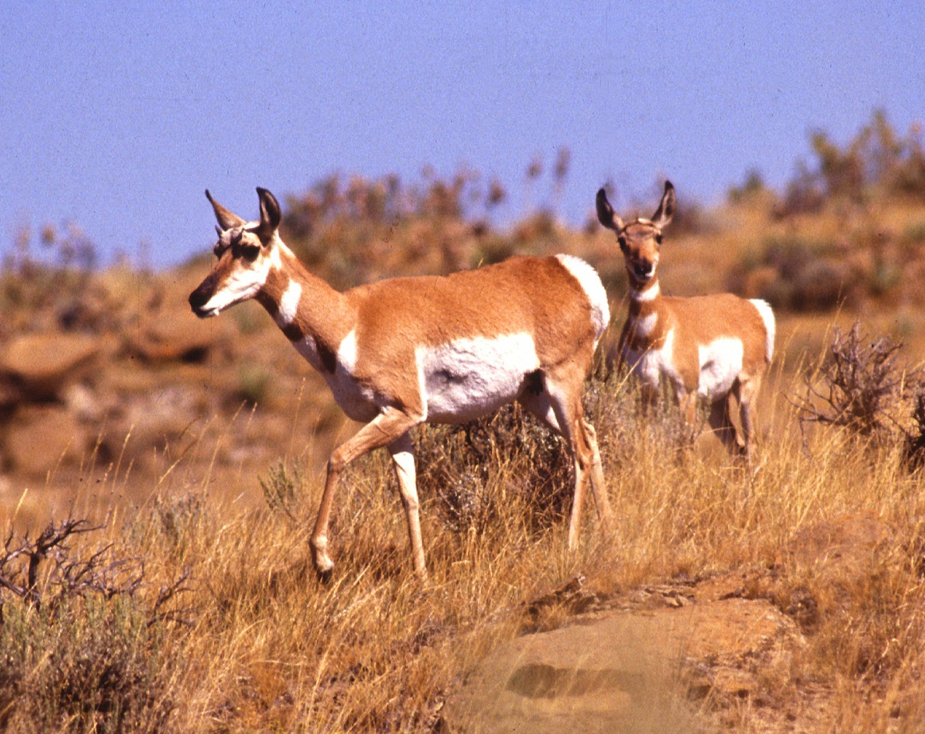
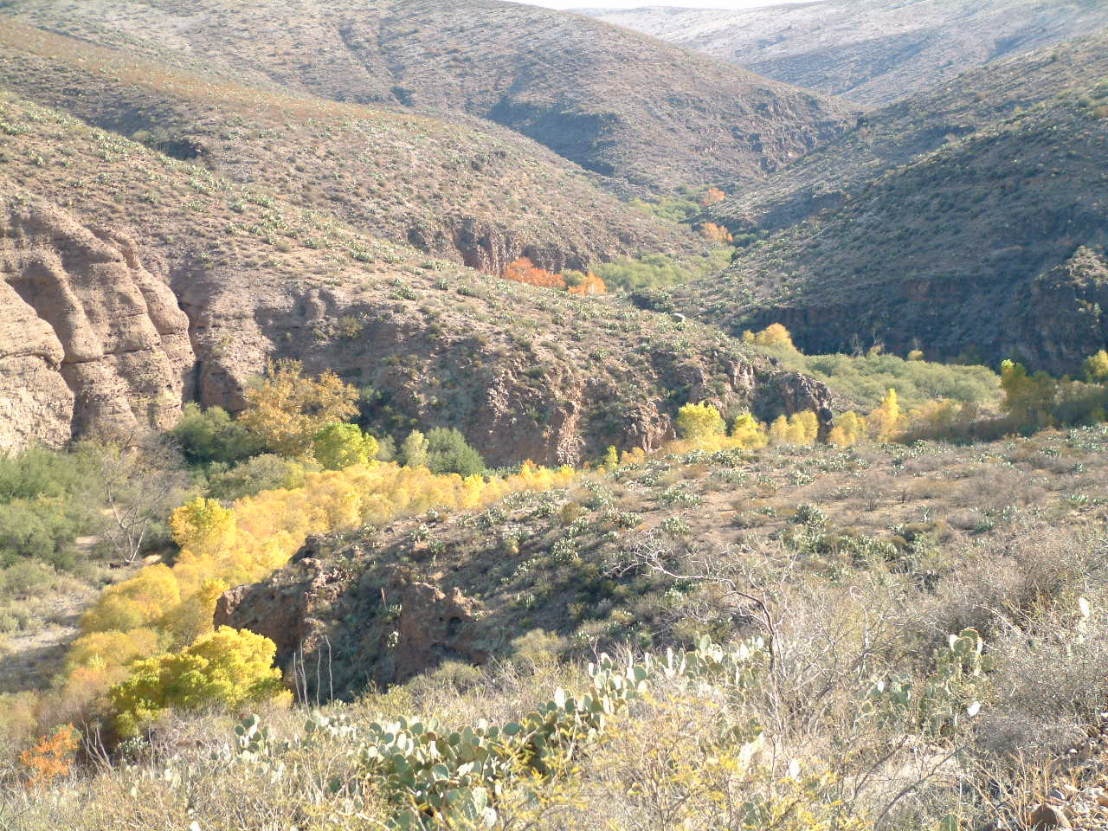
Benefits from ecosystems

Slide 3
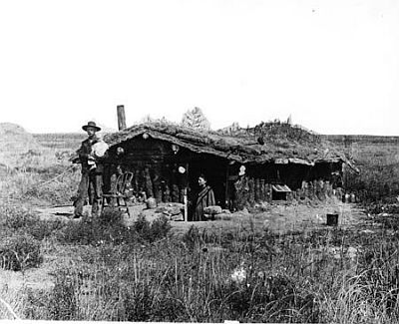
Decision-making

Slide 4
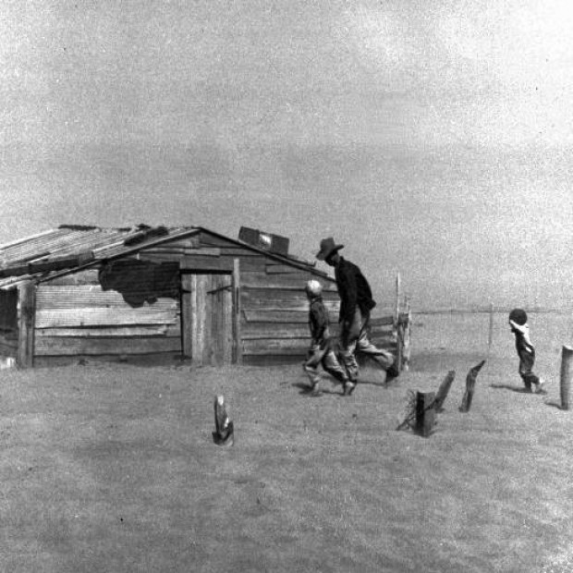
Decision-making

Slide 5
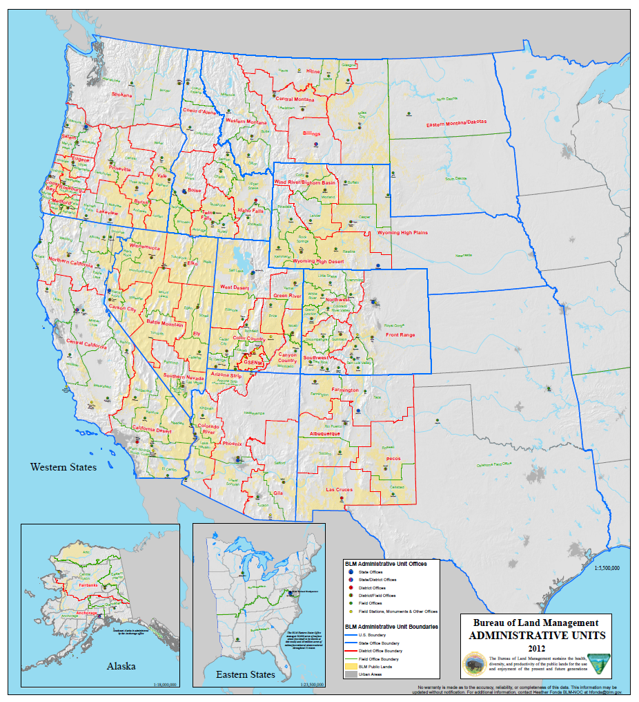
Landscape Approach

Slide 6
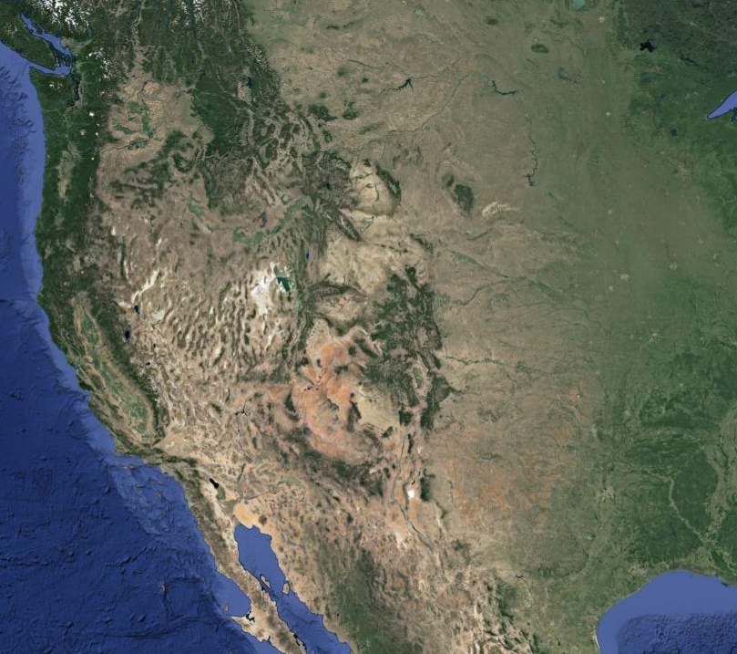
Landscape Approach

Slide 7
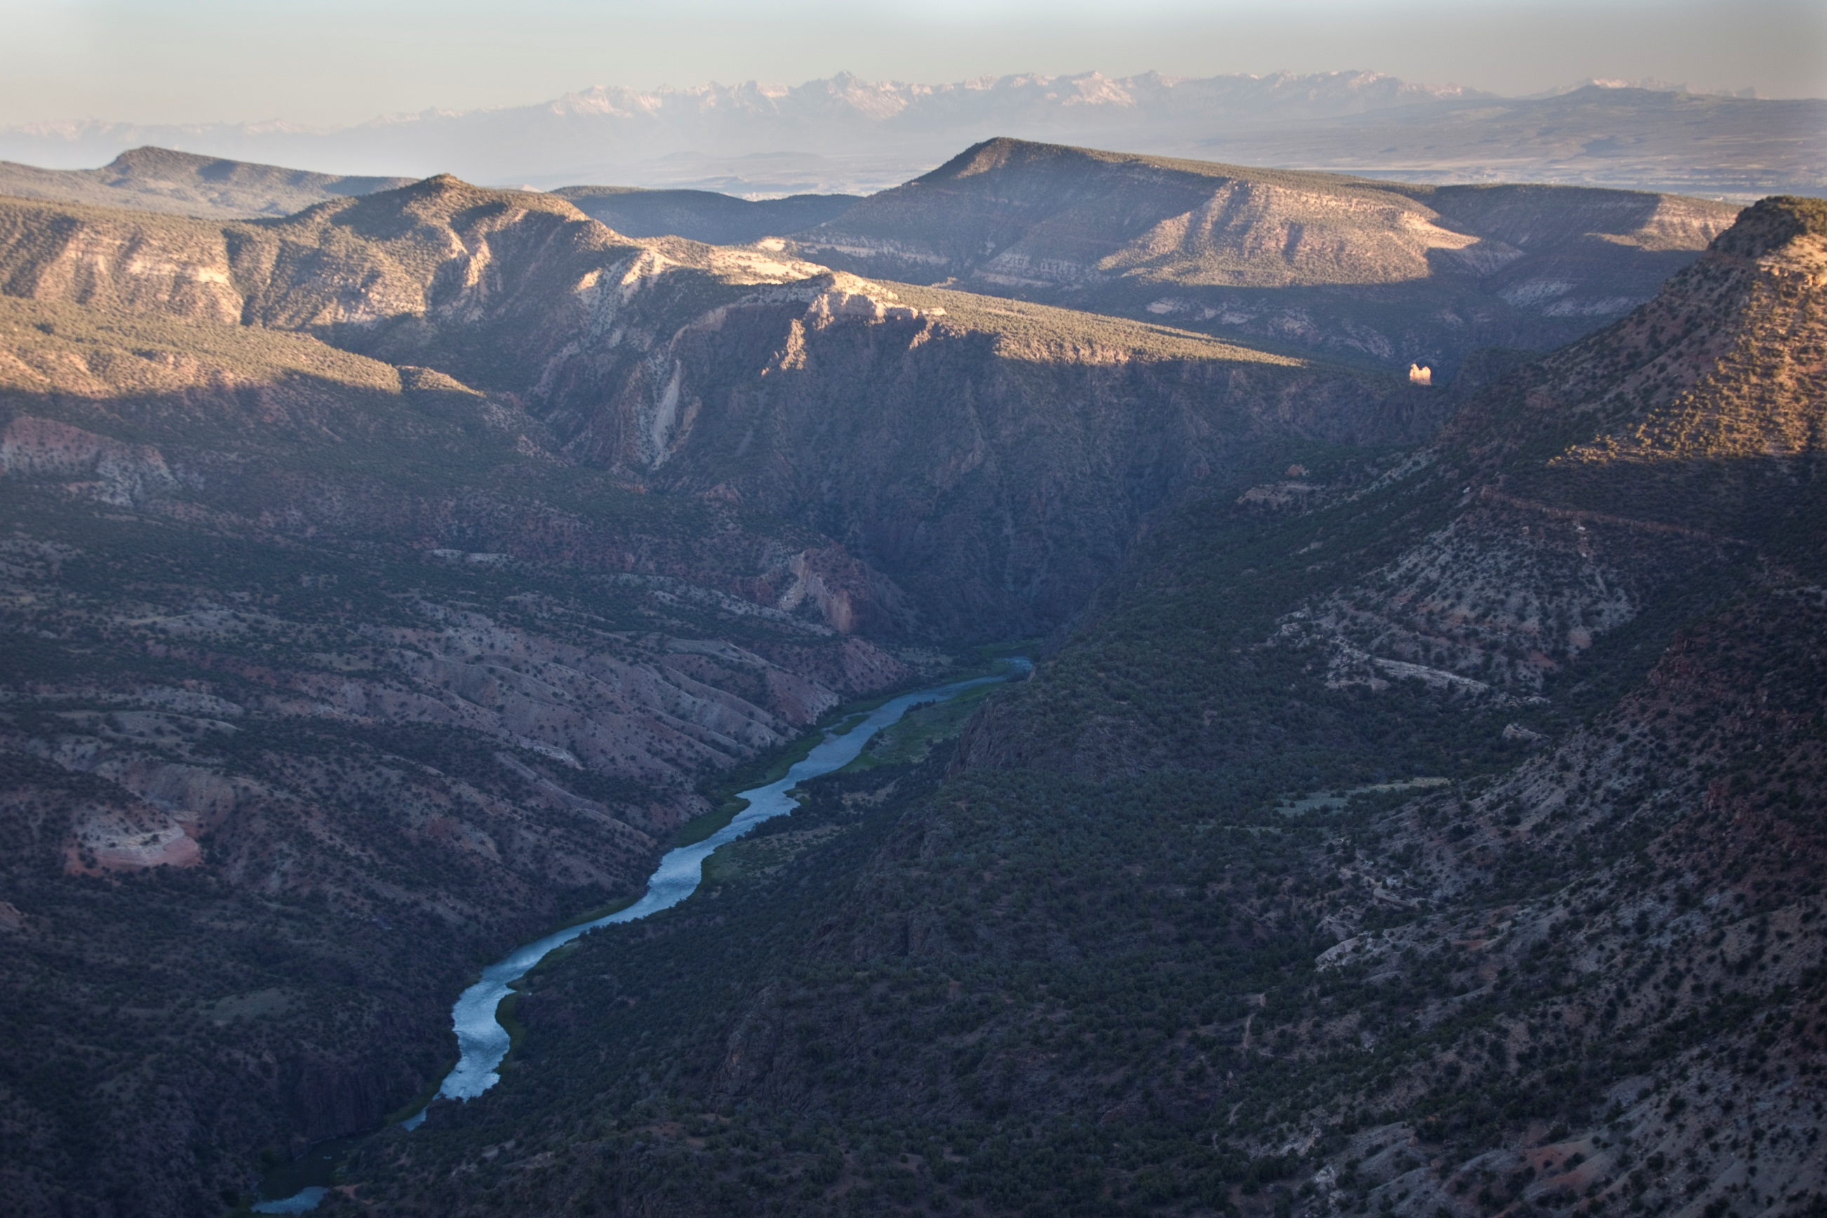
Adaptive Management
BLM Assessment, Inventory, and Monitoring (AIM) Strategy
PLAN
ADJUST
LEARN
DO

Slide 8
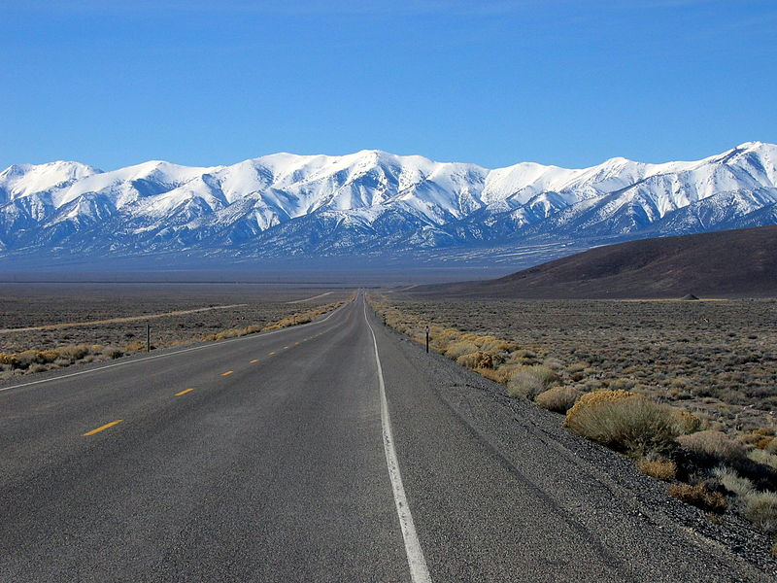
Road Map
AIM Strategy: Monitoring for Adaptive Management
Five Elements of AIM
Applying AIM to Management Decisions

Slide 9
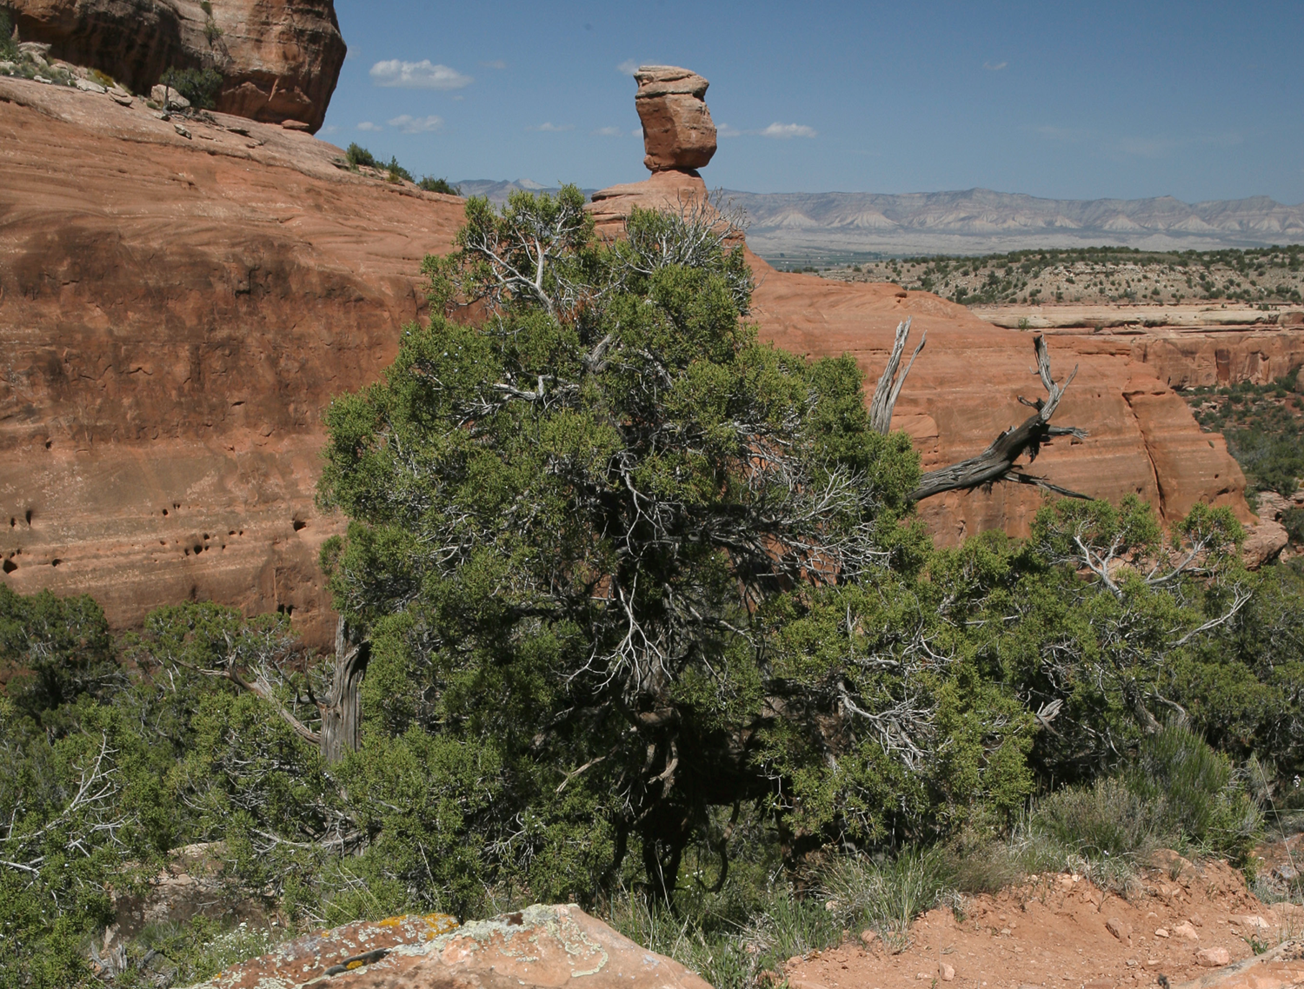
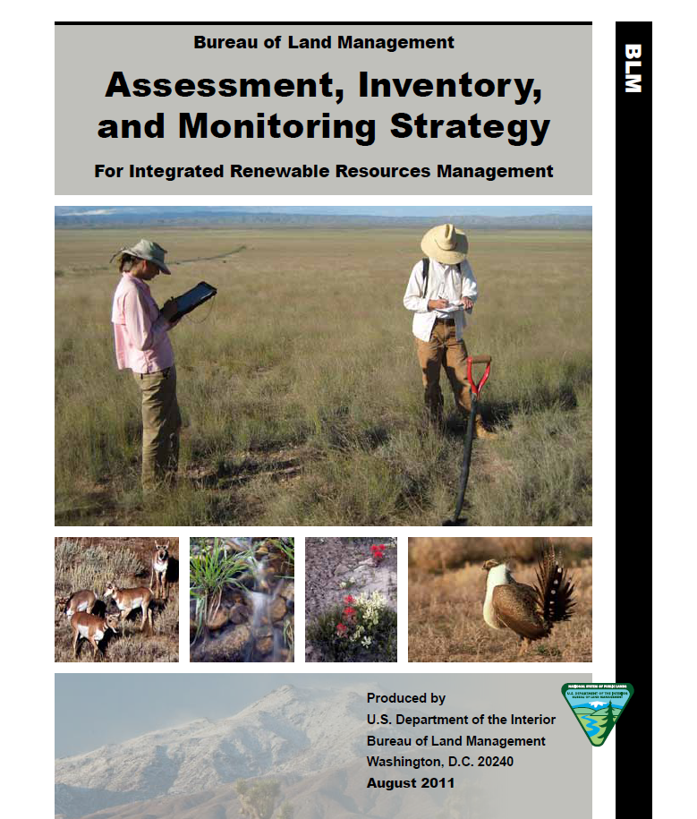
The goal of the AIM Strategy is to report on the status and trends of public rangelands at multiple scales of inquiry, to report on the effectiveness of management actions, and to provide the information necessary to implement adaptive management.

Slide 10
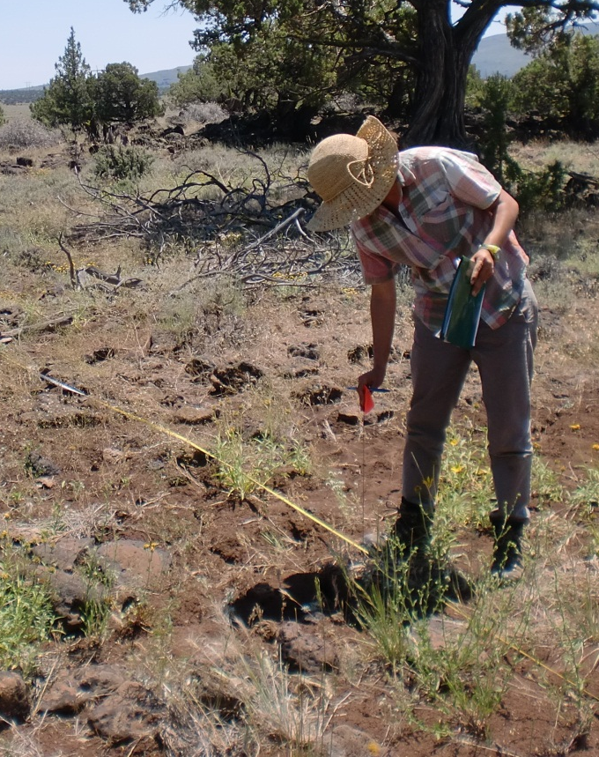
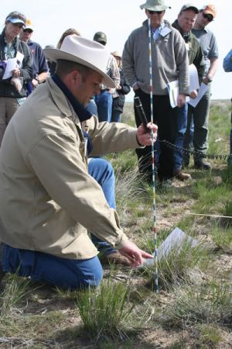
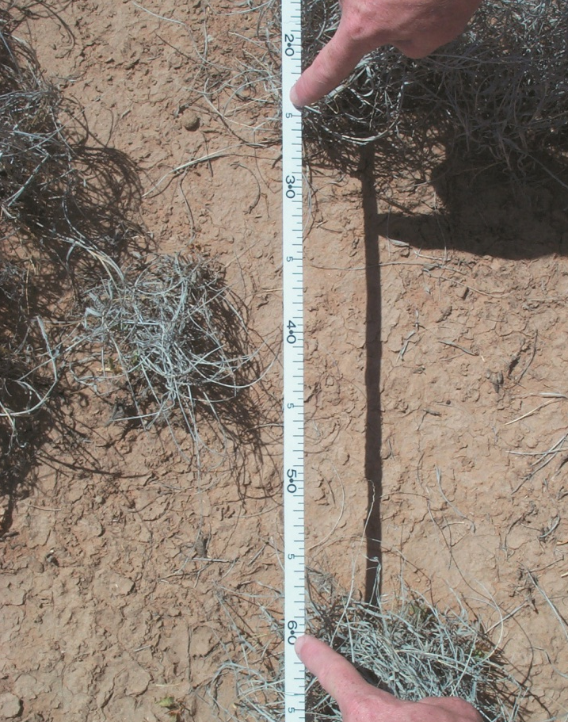
AIM is…
…standard, quantitative indicators and measurements
TERRESTRIAL
Bare Ground
Vegetation Composition
Plants of Mgmt. Concern
Height
Canopy Gaps
Nonnative Invasive Sp.

Slide 11
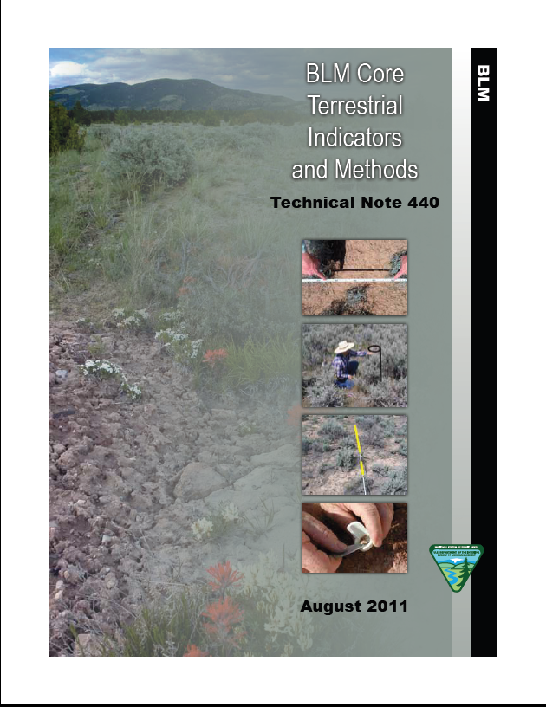
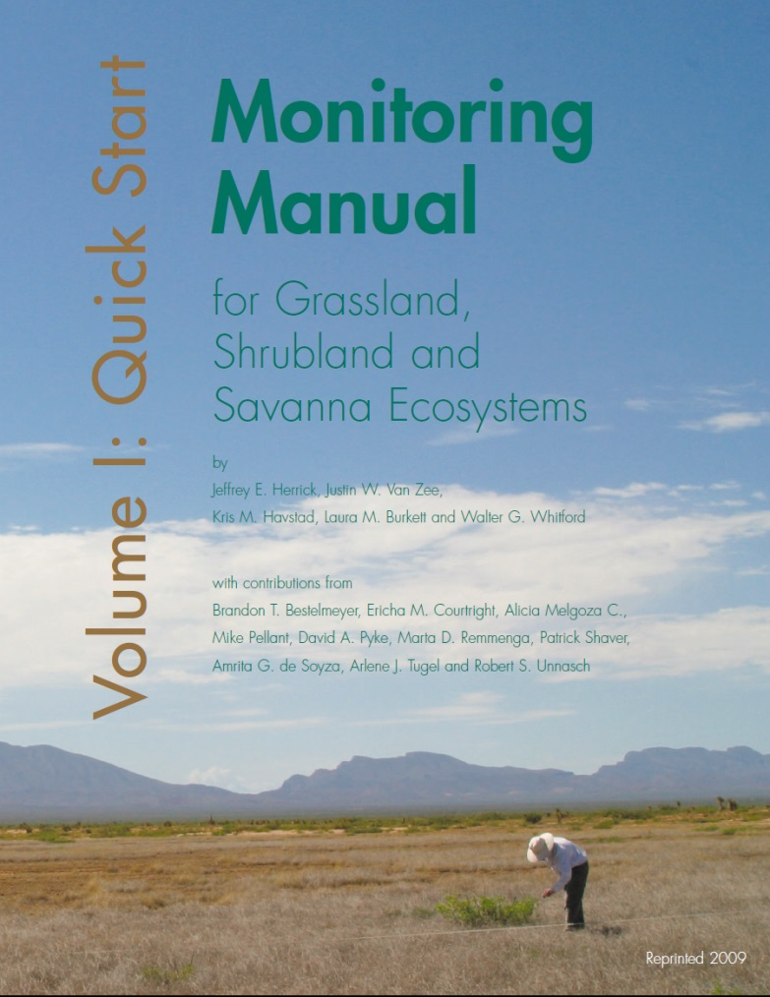





AIM is…
…standard, quantitative indicators and measurements
TERRESTRIAL
In Revision

Slide 12
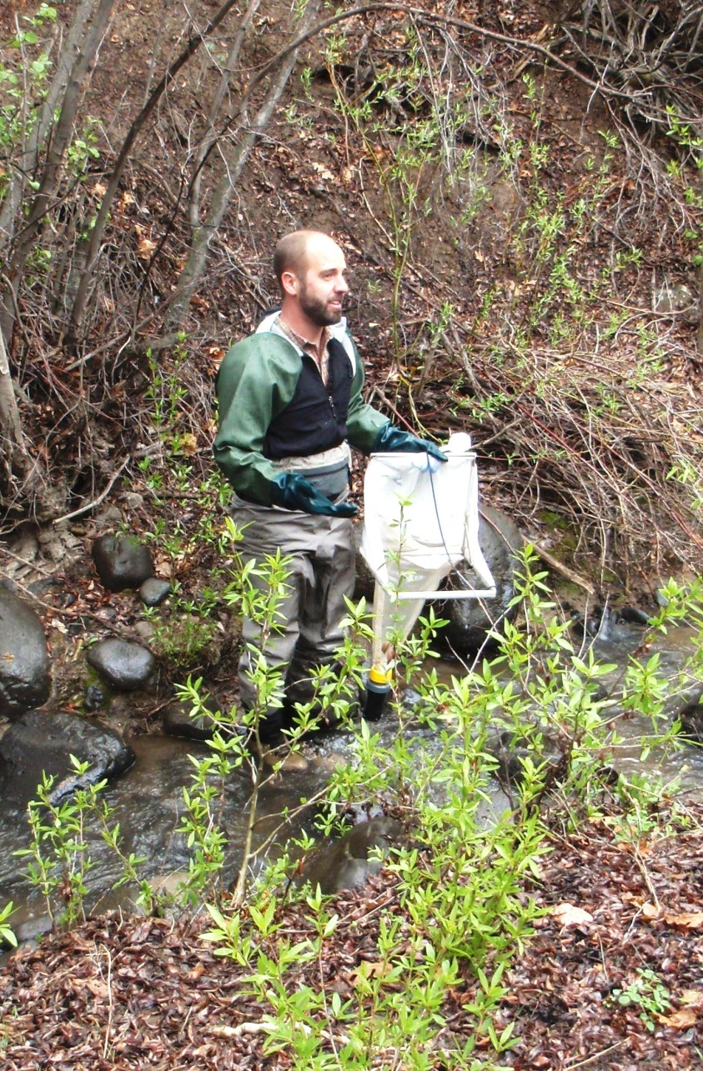
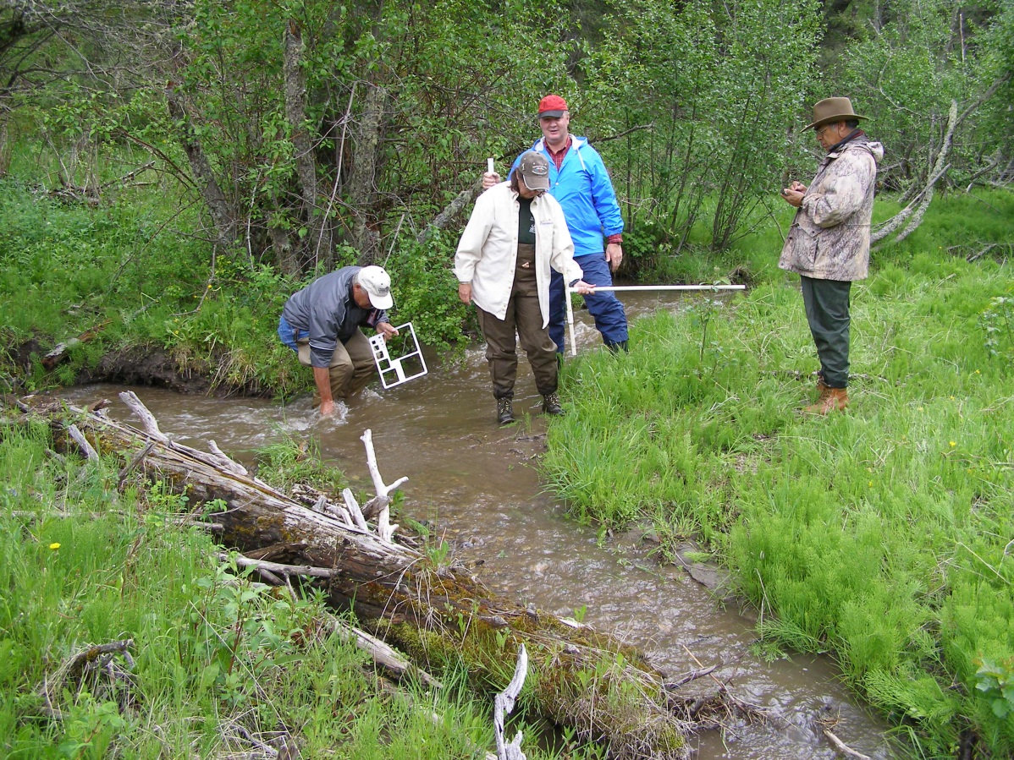
AIM is…
…standard, quantitative indicators and measurements
AQUATIC
Acidity, Salinity and Temperature,
Pool Dimensions, Stream Bed Substrate, Bank Stability, Floodplain Interaction,
Macroinvertebrates, Riparian Vegetation, Canopy Cover

Slide 13
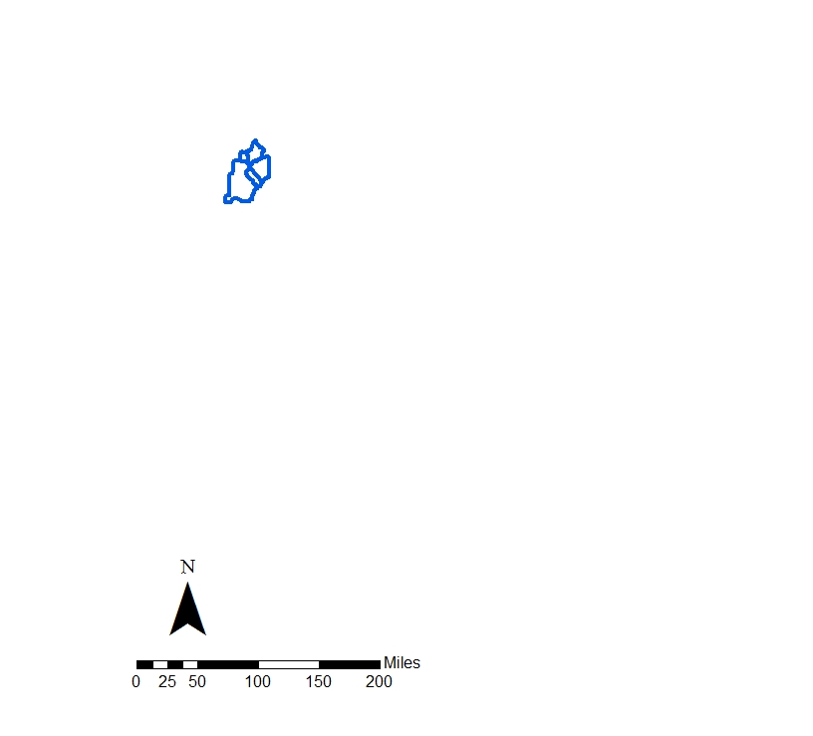
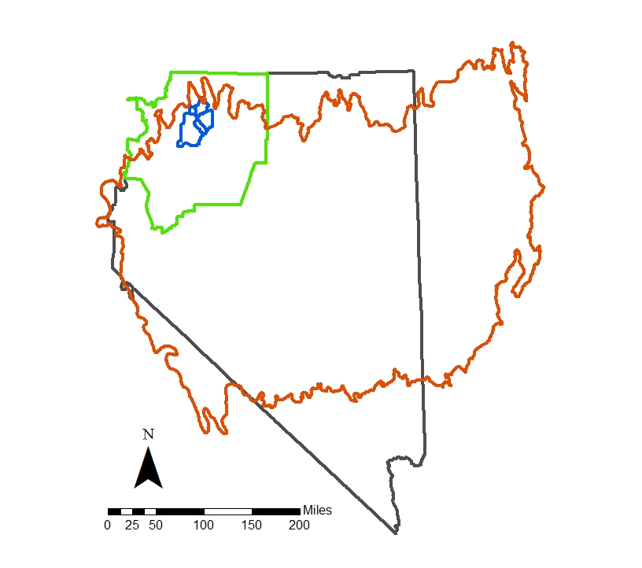
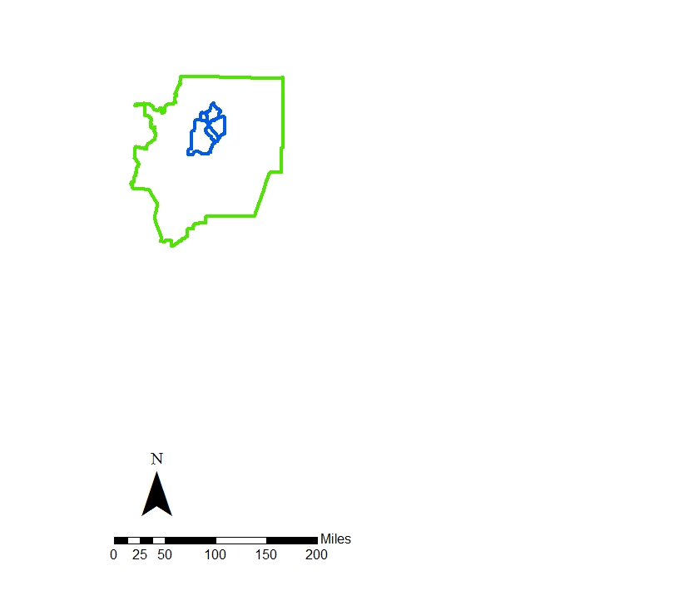
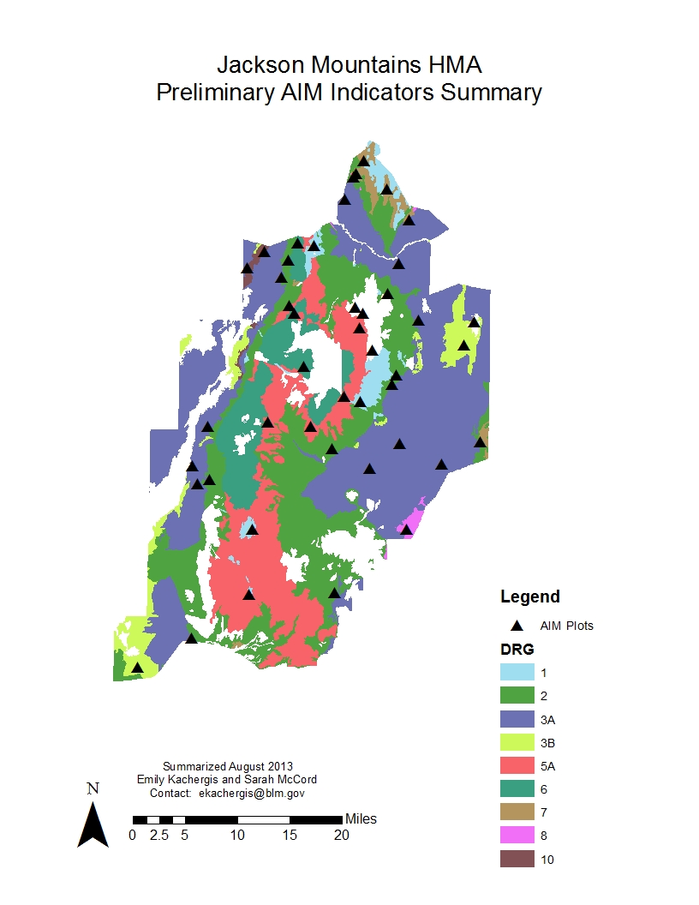
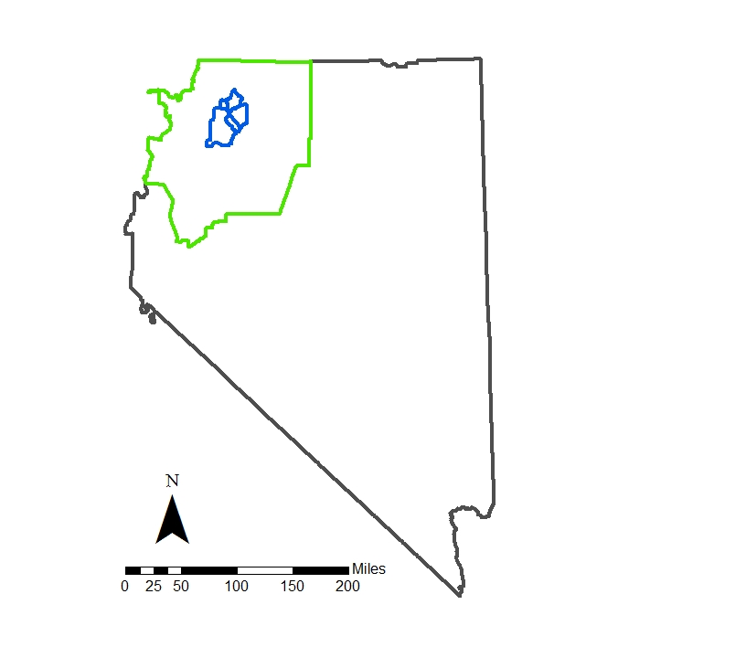
AIM is…
…statistically valid, scalable sampling design
(2011)
(N=4)
(N=7)
(N=7)
(N=5)
(N=5)
(N=4)
(N=5)
(N=2)
(N=3)

Slide 14
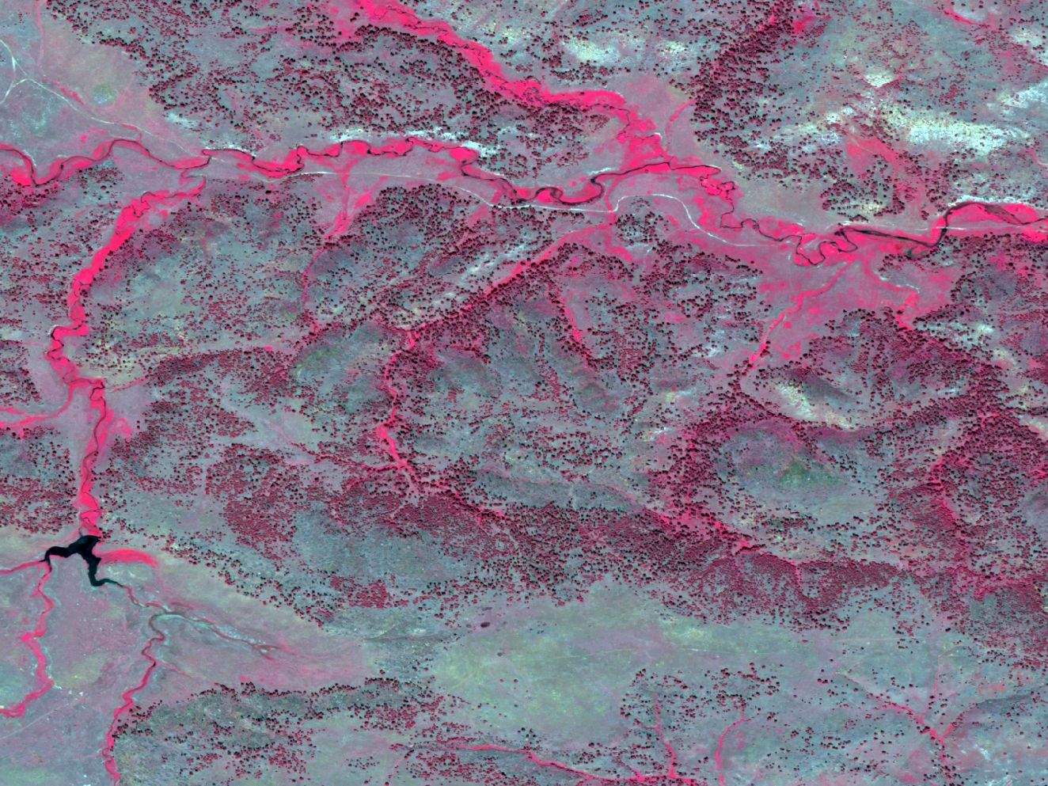
AIM is…
…integrated with remote sensing

Slide 15

AIM is…
…managed data

Slide 16

AIM is…
…managed data
Enterprise
database
BLM National Operations Center

Slide 17

AIM is…
…structured implementation
Use data to inform adaptive management
Repeat monitoring annually
Evaluate data and adjust monitoring if needed
Implement monitoring program
Develop monitoring program

Slide 18



AIM
Data
Collect data once, use it many times.

Slide 19
Example AIM Applications
National Condition of Rangelands
Sage Grouse Habitat
Effectiveness of Management Plans
Solar Energy Development
Emergency Stabilization and Rehabilitation
Grazing Management
SCALE

Slide 20
BLM Fundamentals of Land Health
Watershed Function
Ecological Processes
Water Quality
Habitat Quality (for T&E & Special Status Species)

Slide 21
Adaptive Management
Objectives based on BLM Land Health Fundamentals
PLAN
Monitoring
ADJUST
LEARN
DO

Slide 22
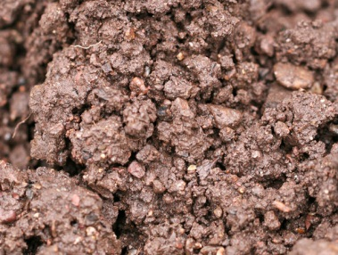

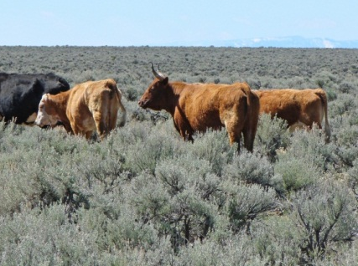


Adaptive Management
Objectives based on BLM Land Health Fundamentals
PLAN
Monitoring
ADJUST
LEARN
DO

Slide 23
Objectives based on BLM Land Health Fundamentals
PLAN
Monitoring
ADJUST
LEARN
DO
Adaptive Management

Slide 24
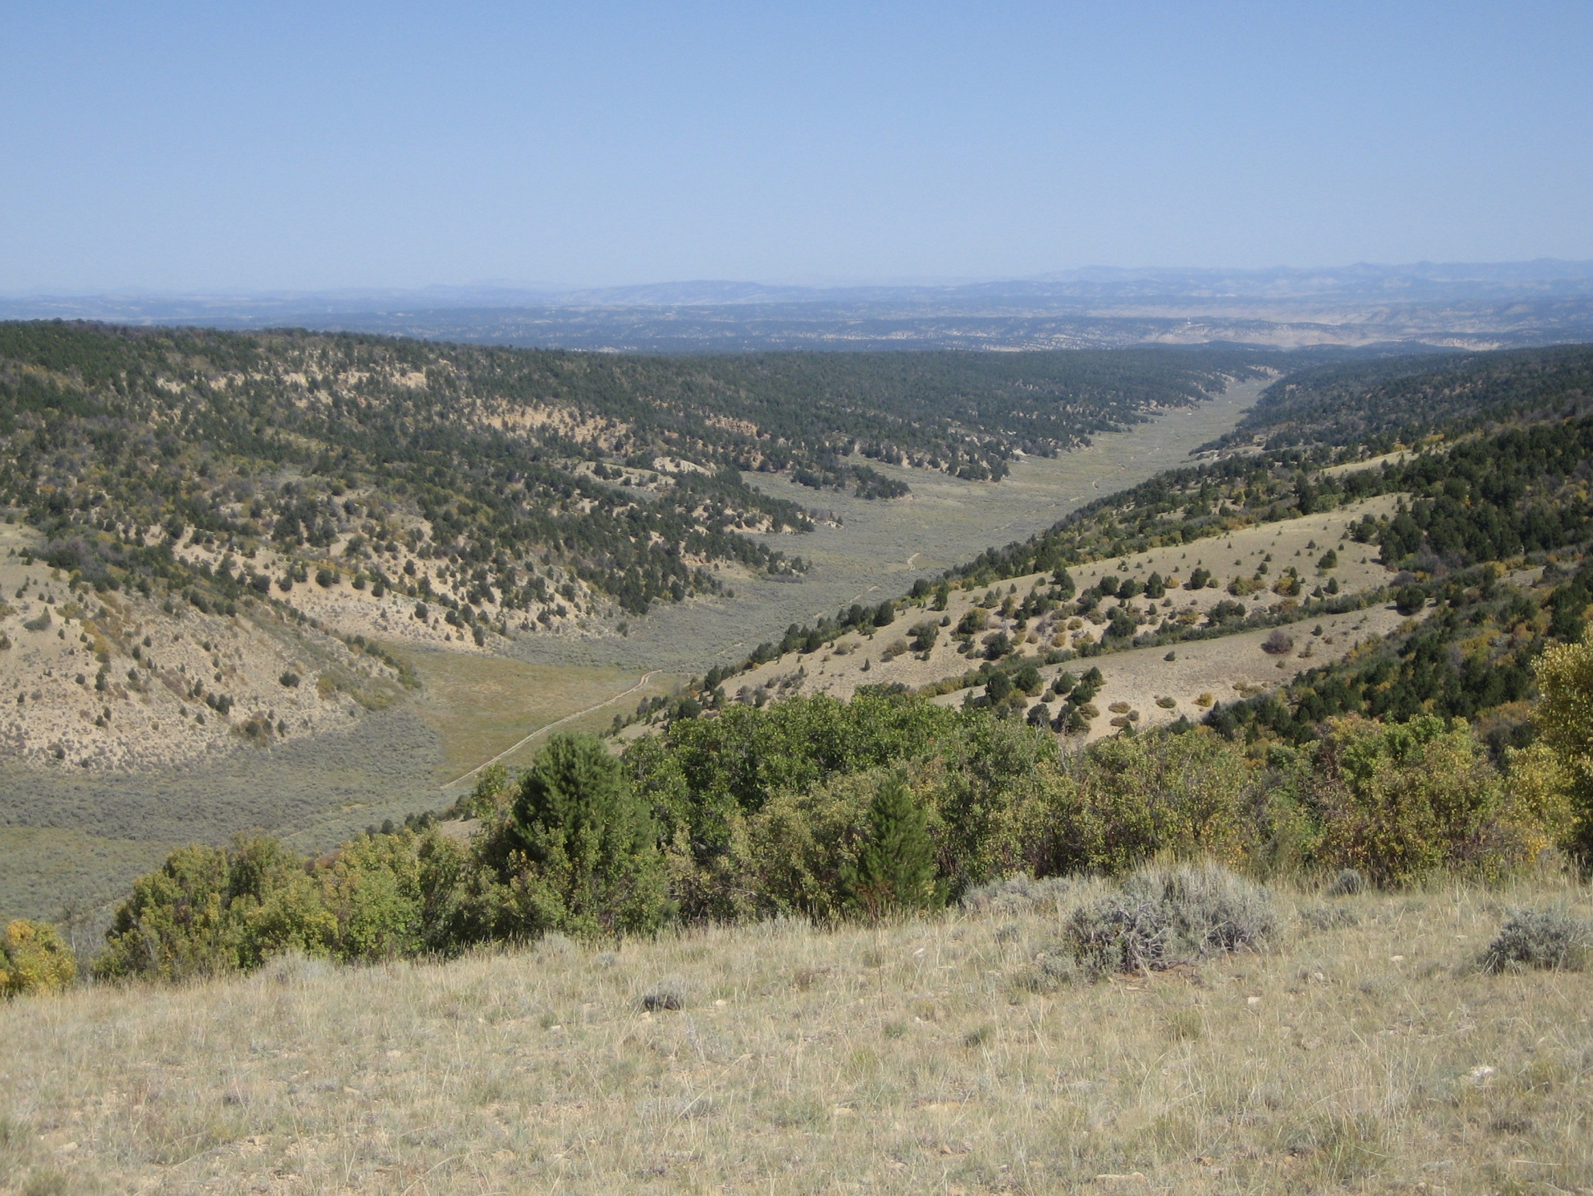








Thanks!
National AIM Team: Gordon Toevs, Carol Spurrier, Emily Kachergis, Scott Miller, Matt Bobo, Sherm Karl, Melissa Dickard, Sarah Lamagna, Bob Boyd, Jason Karl (ARS), Sarah McCord (ARS)
BLM AIM State Monitoring Coordinators and District/Field Office Project Leads
Collaborators: USDA-ARS Jornada, NRCS, USGS, Great Basin Institute, Alaska Natural Heritage Program, Iowa State University, and many more

Slide 25
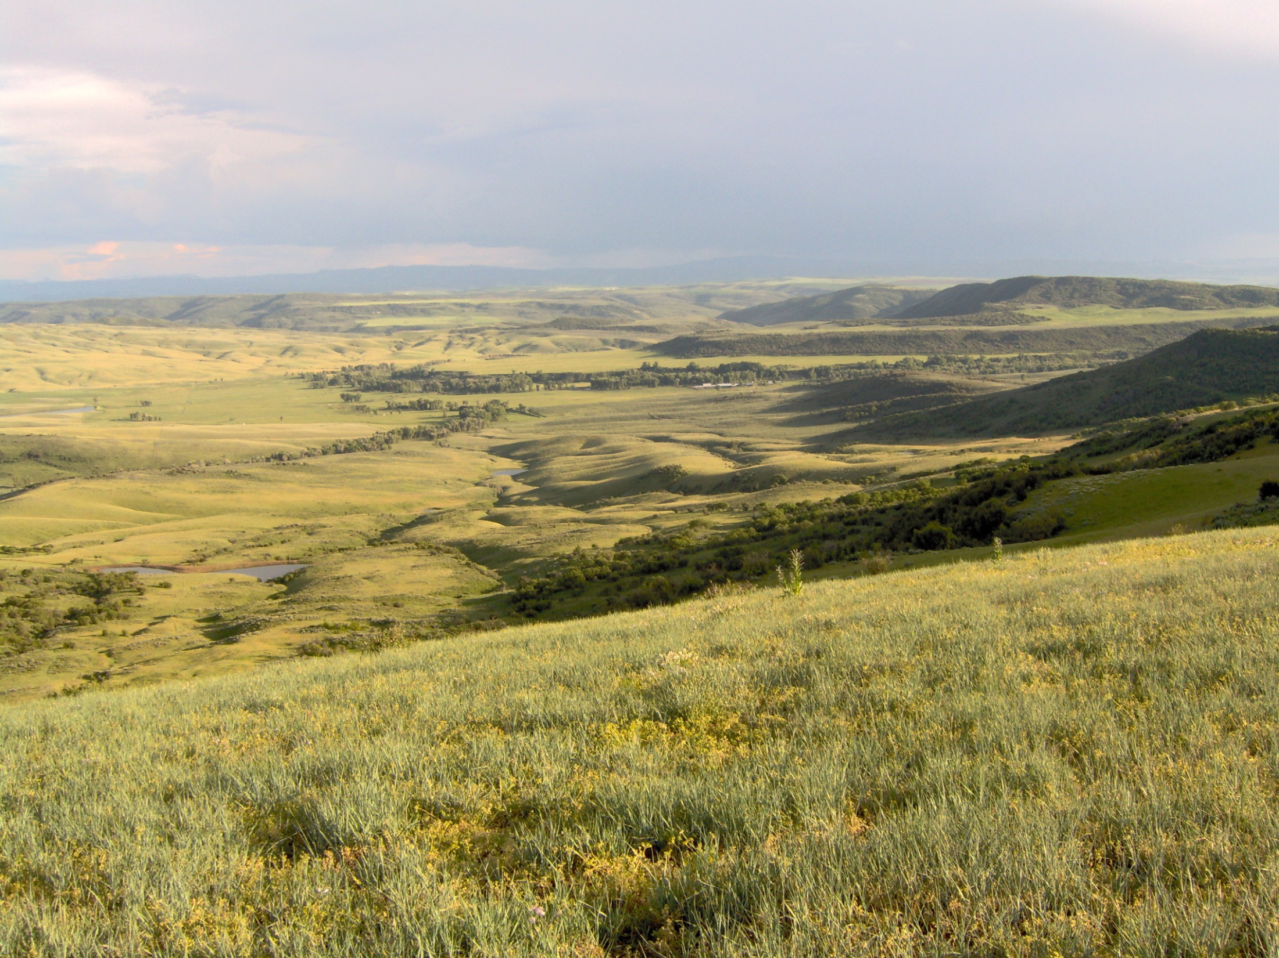
Questions?
Contact: Emily Kachergis
303-236-0071
ekachergis@blm.gov
AIM Coordinator: Gordon Toevs
202-912-7202
gtoevs@blm.gov

Slide 26
To Learn More:
National AIM Website: http://www.blm.gov/wo/st/en/prog/more/Landscape_Approach/Monitoring_for_Adaptive_Management.html
AIM SharePoint Site (contact Emily Kachergis, ekachergis@blm.gov)

