Slide 1

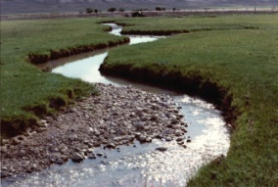
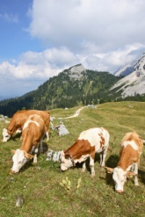
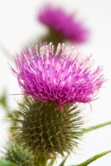
Wyoming Team Report Reno, March 2010
Members Attending
Mark Gorges
John Henderson
Dennis Doncaster
Kellie Roadifer
Steve Kiracofe
Carl Bezanson

Slide 2
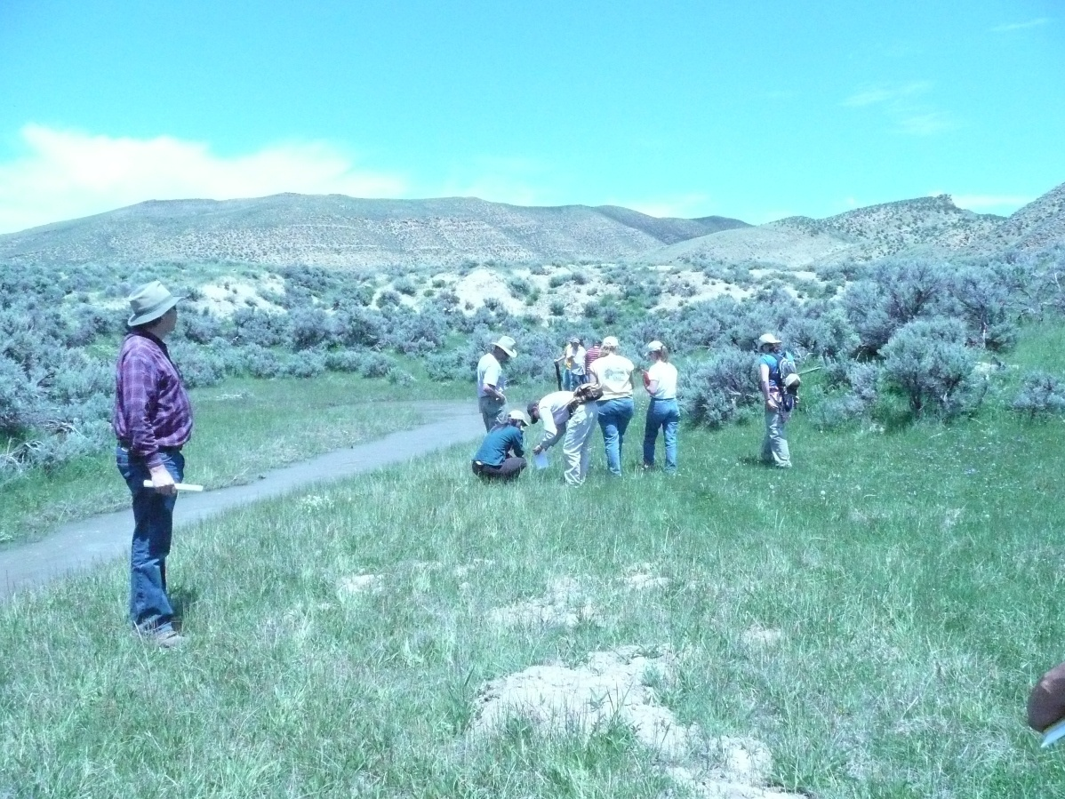
2008 PFC Class – Rawlins, WY

Slide 3
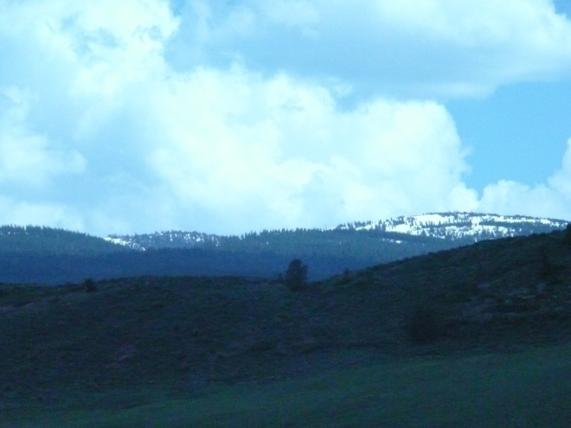
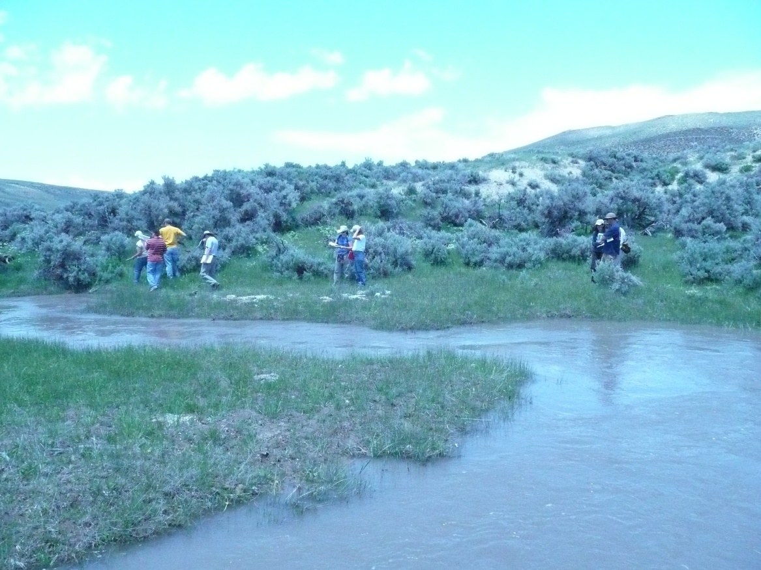
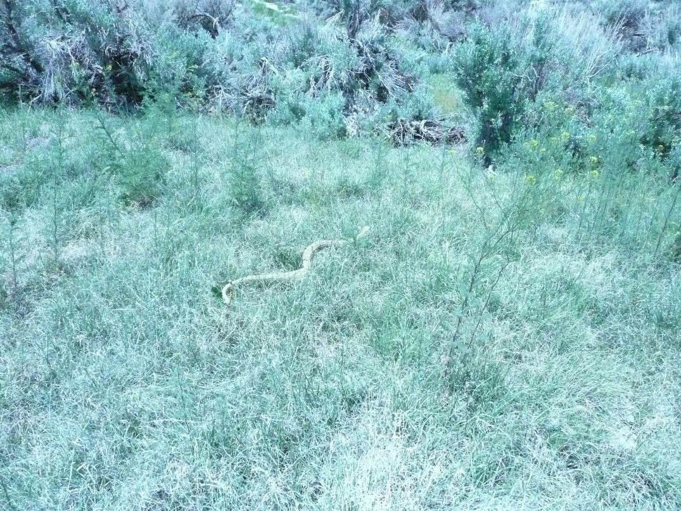
Mid-June in Wyoming

Slide 4
2008 Accomplishments
April – Abbreviated PFC awareness class conducted by Cheryl Newberry for 11 community college students.
17/18 June – The team conducted a two-day PFC class in Rawlins, WY; there were 9 participants.
The WY Team Lead continued to work with NRST on the C&C Desk Guide

Slide 5
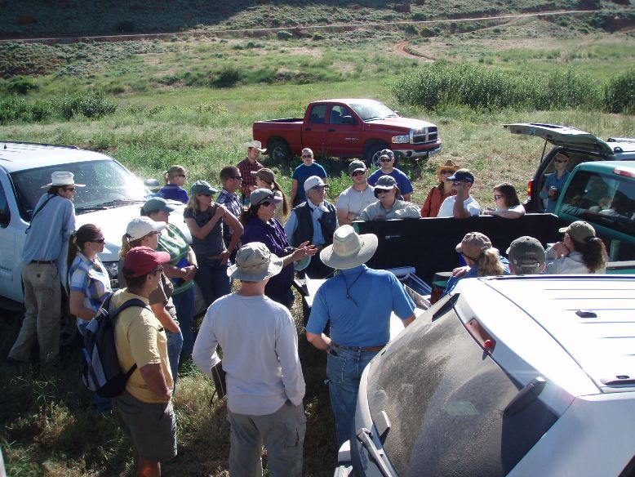
2009 PFC Class – Lander, WY

Slide 6
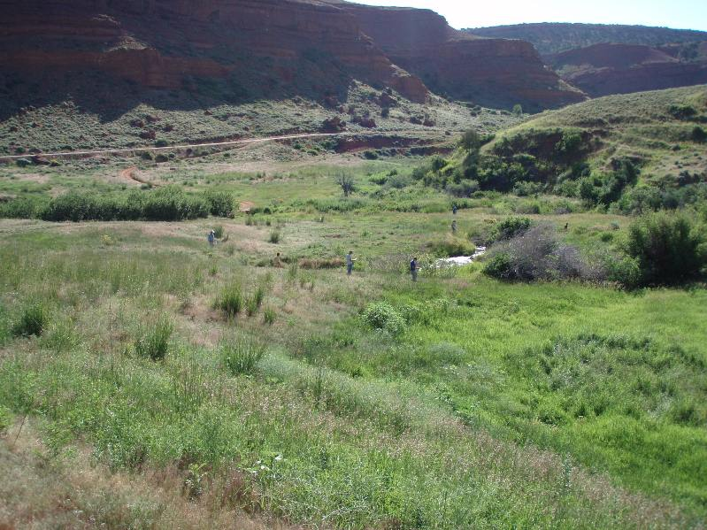
Stream Assessment - PFC Class

Slide 7
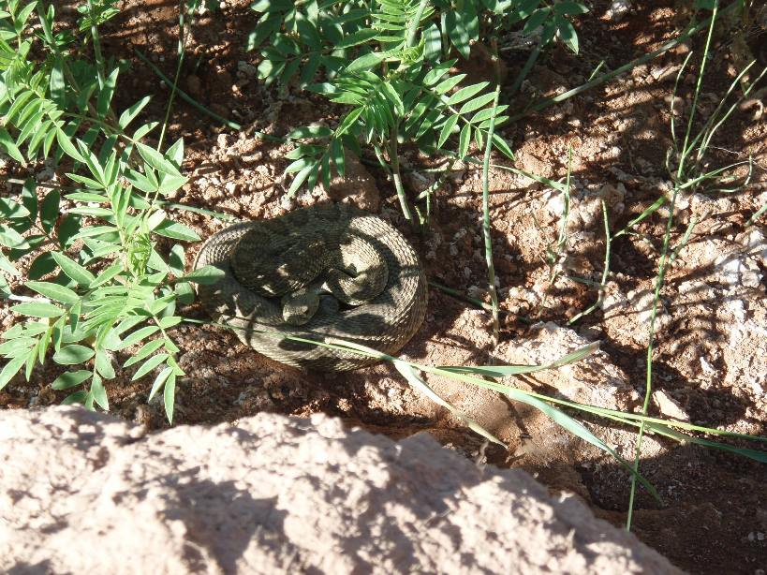
Tall Grass Hazard

Slide 8
The Not So Good on BLM

Slide 9
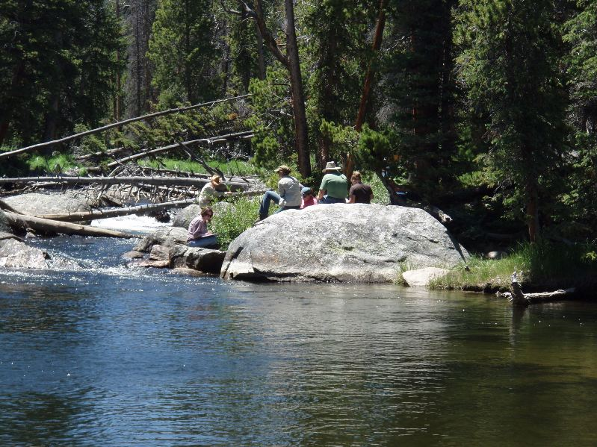
The Good Stuff On the Forest

Slide 10
2009 Accomplishments
April – Abbreviated PFC awareness class conducted by Cheryl Newberry for 15 community college students.
14-16 July – The team conducted a three-day PFC class in Lander, WY; there were 31 participants.
14-17 September – Team leader assisted NRST with teaching Aerial Photography Analysis of PFC class in Elko, NV.
Recruited Amy Nowakowski, Bighorn National Forest hydrologist, to be part of the Wyoming team.

Slide 11
Impact – Teaching the PFC concepts and process to new young professionals
Successes – Team is very experienced in using PFC concepts on the ground
Challenge – Maintaining management support for team members
Evolution – Bringing NRST to Wyoming, 2010 - Encouraging the use of MIM - Lobbying for BLM District Riparian Teams
- Holding onto the Green Zone

Slide 12
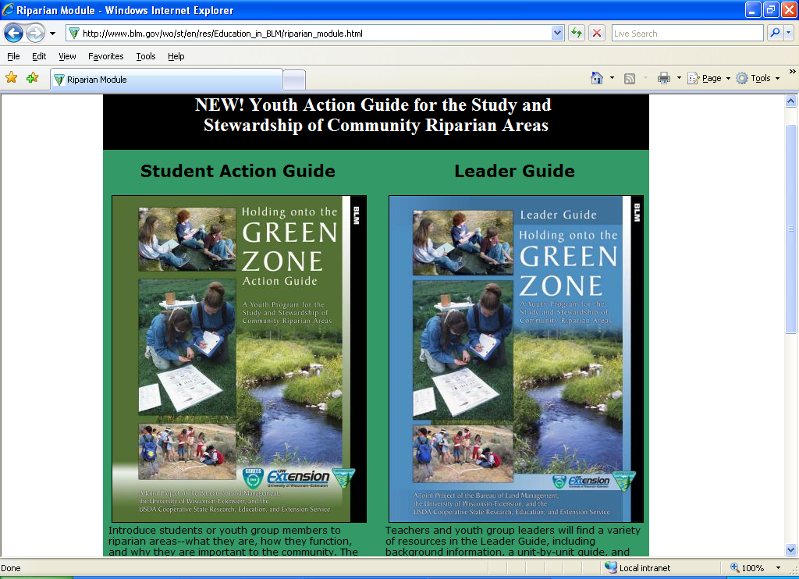
New for 2010

Slide 13
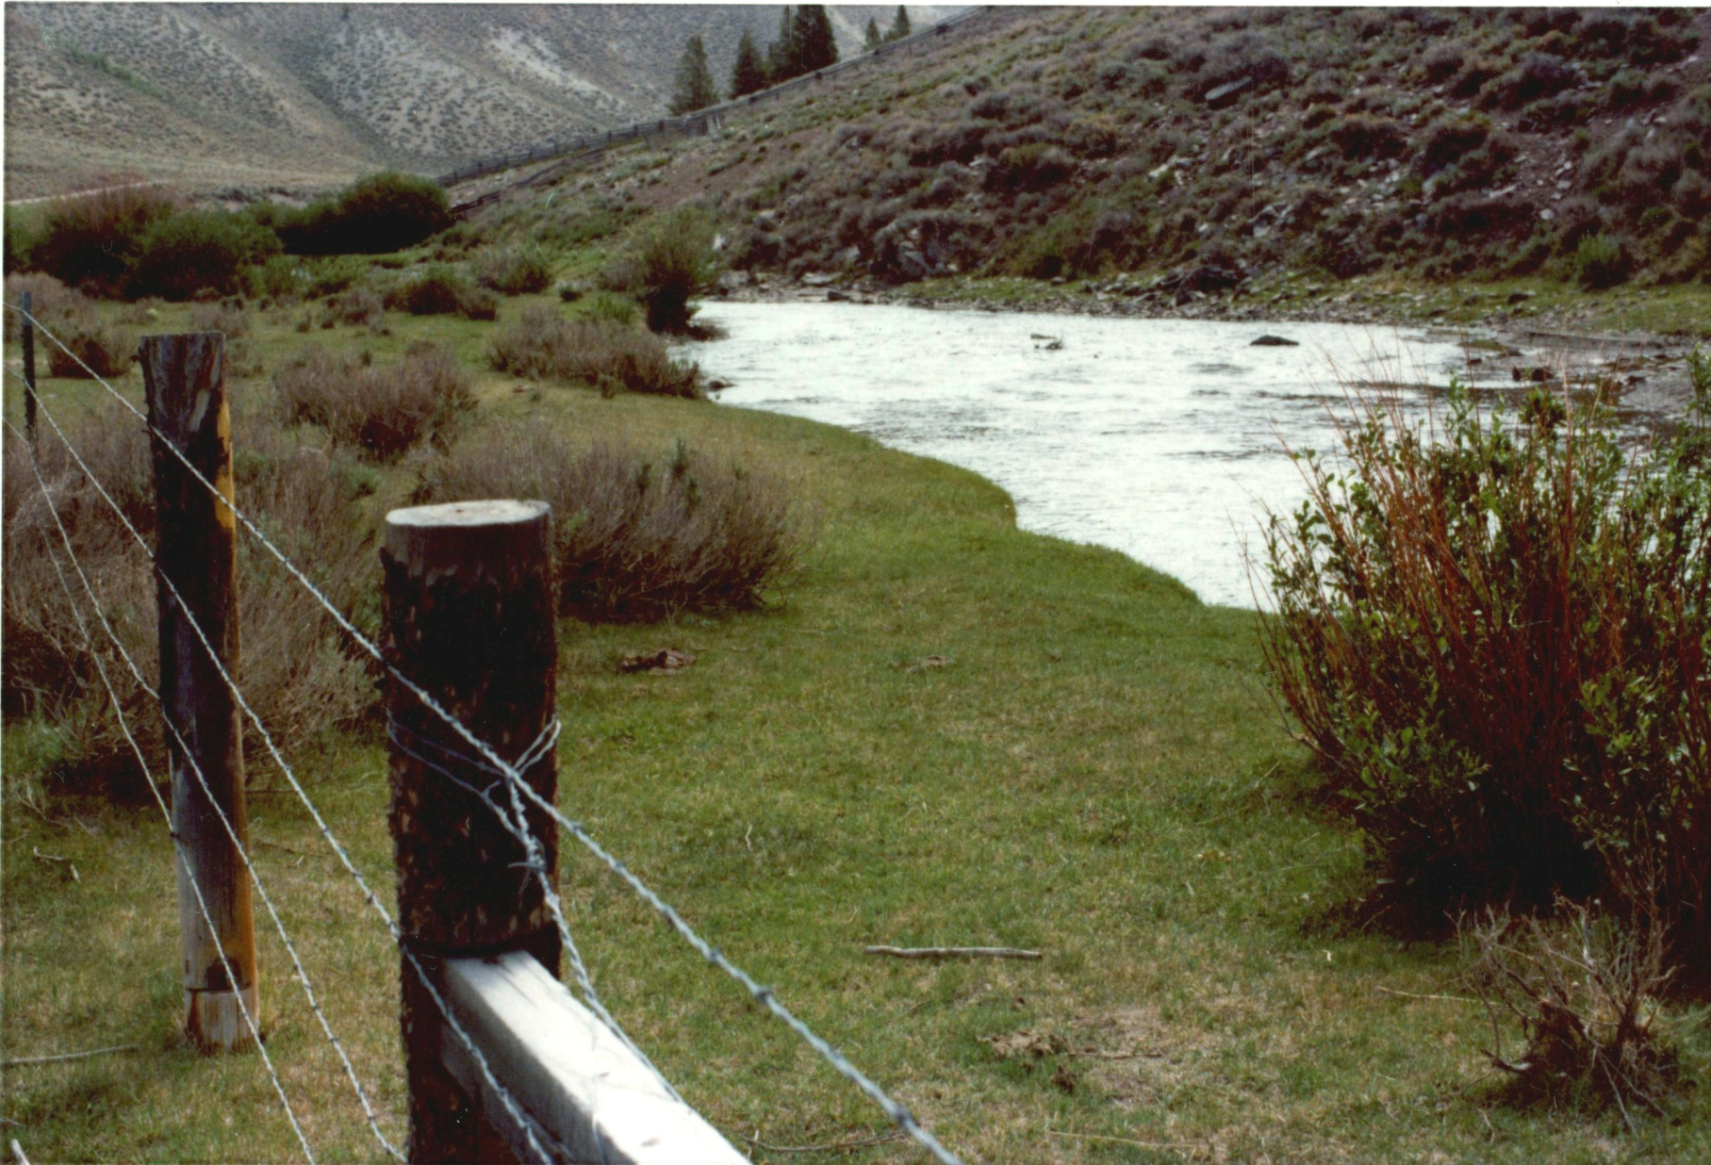
La Barge Creek
Western Wyoming July 1977 – note the new fence

Slide 14
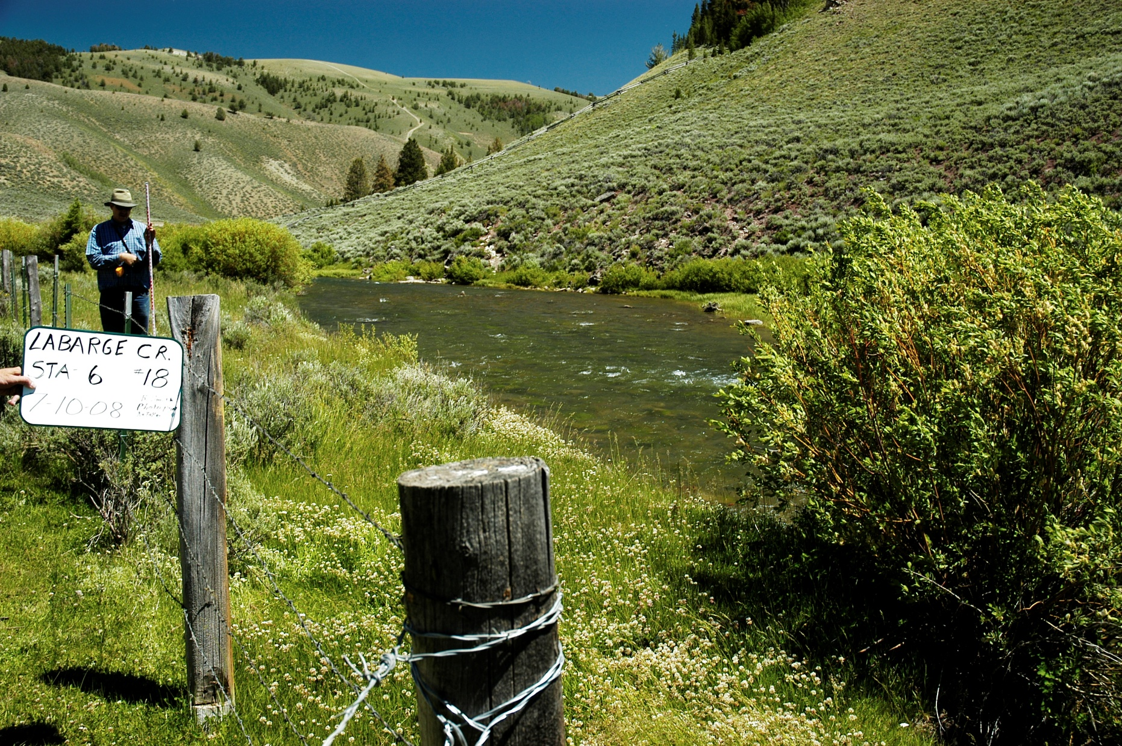
La Barge Creek
July 2008 - 31 years of keeping the cows our of the stream

Slide 15
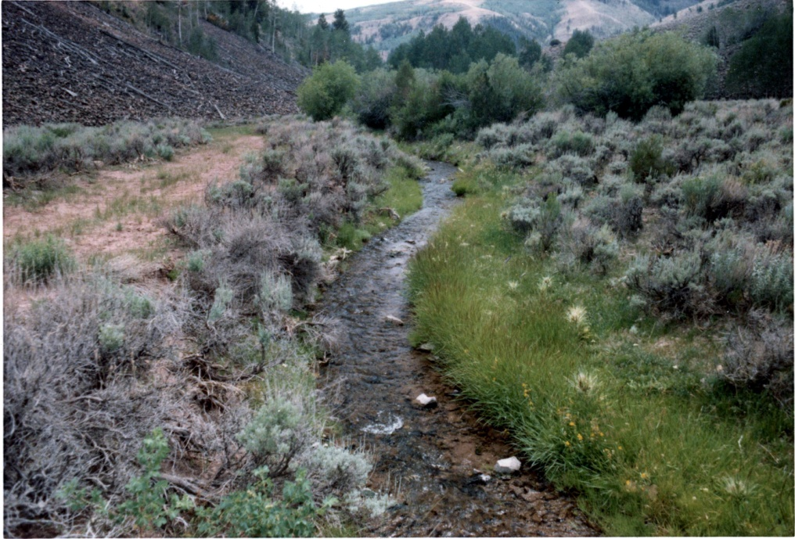
Rock Creek
Western WY, July 1977, Colorado River cutthroat stream

Slide 16
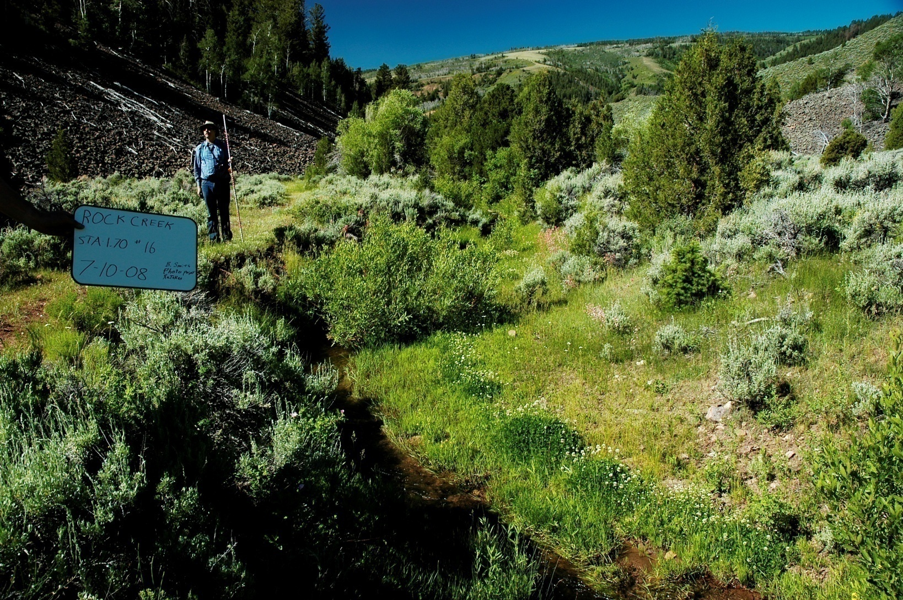
Rock Creek
31 years later

Slide 17
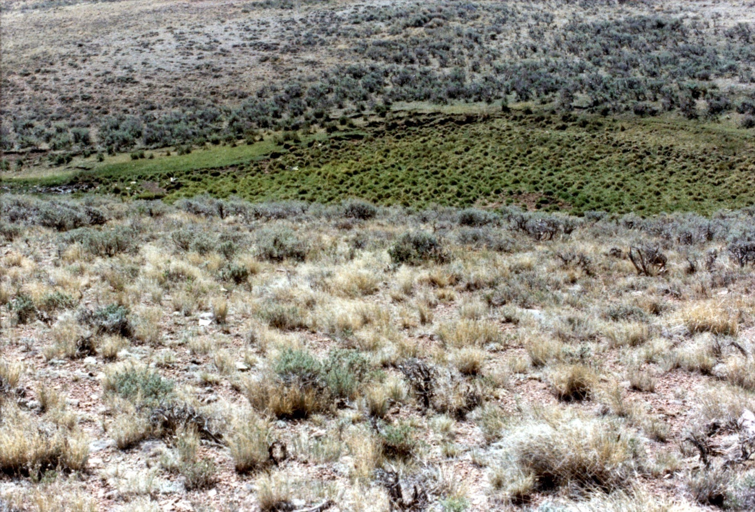
Trail Creek
Western WY – July 1977

Slide 18
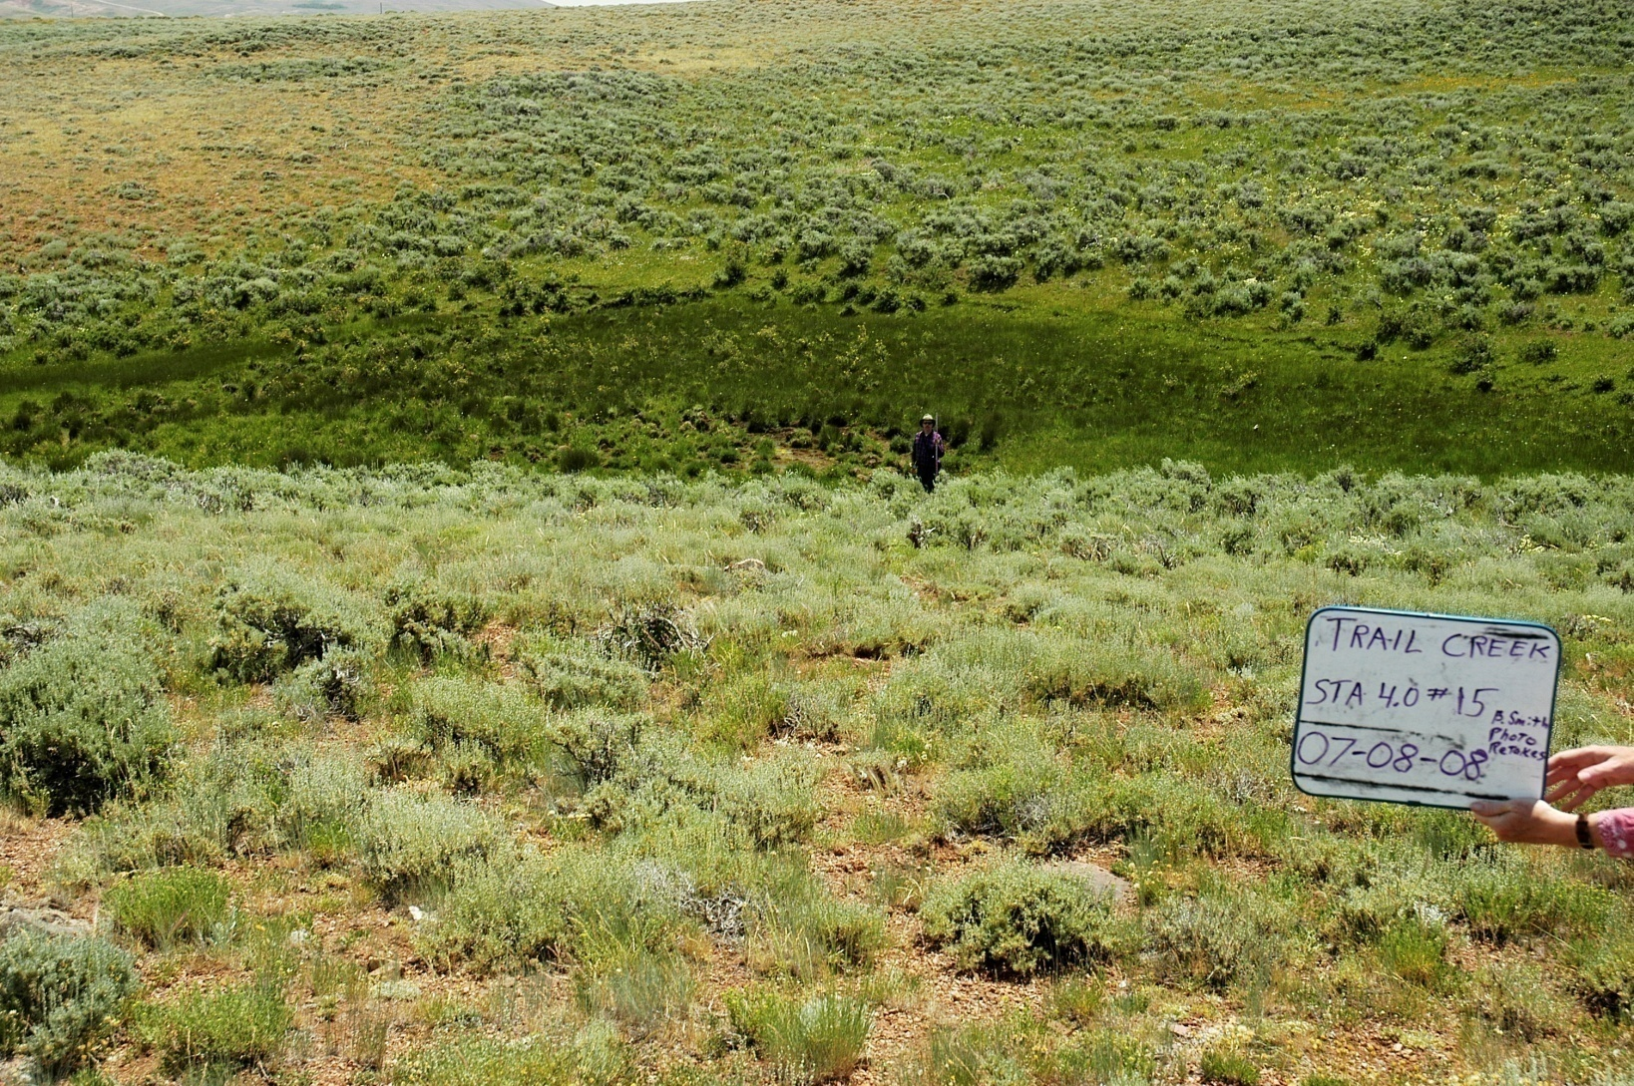
Trail Creek
Recovery – 31 years later

