Slide 1
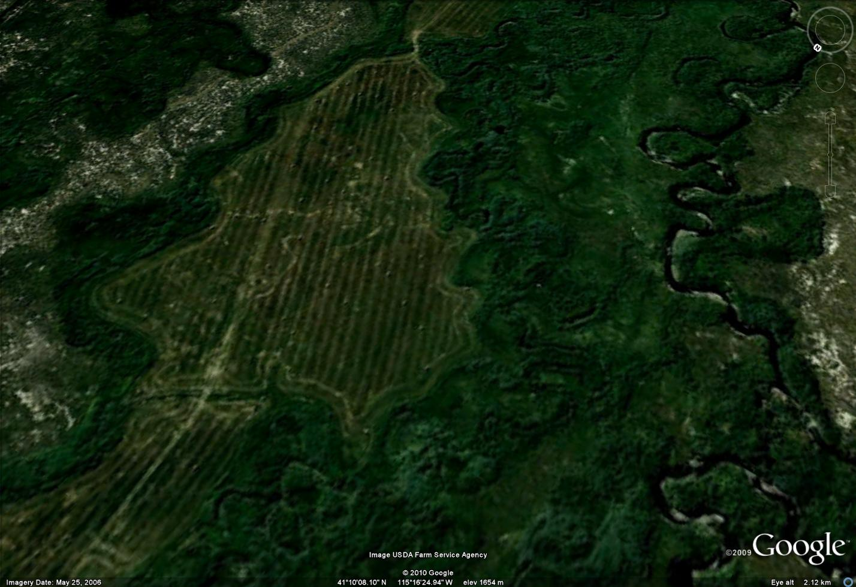
Nevada Creeks and Communities Team
Accomplishments in 2008-9
Sherman Swanson
Coordinator

Slide 2
NV Creeks and Communities Team Most Active Teachers
Sherm Swanson, Range w/wildlife, hydro, soils
Kent McAdoo, Wildlife and range
Gary McCuin, Range and economics
Bob Boyd & Barbara Drake, Hydrology
Paul Blackburn & Desi Zamudio, Soils
Bill Dragt & Chuck Petersen, Range
Dan Gralian & Jerry Annis, Ranch management
Pat Coffin & Carol Evans, Fisheries
Notes:
The most active partners in the Nevada Cadre come from a variety of disciplines --

Slide 3
Accomplishments
Two-day PFC Classes (6):
  Pine Valley, Bridgeport,
  Bishop (w/CA), Nixon,
  Elko, & Ely,
Grazing Management for Riparian Wetland Areas - Winnemucca,
Short talks (32):
  NRES 295, Hohhot China, NYRC x 2,
  LIFE, RMS, EPA/Tribes x 2,
  Elko x 3, Portland AFS x2, HSYF x 2,
  Nixon, GLCI x 2, SRM x 3,
  Reno x 8, Lovelock, Lee,
  Yomba,

Slide 4
Accomplishments
Posters (6) - Hohhot x 4, NAES, & NvCA
Publications (7):
  JAWRA, IRC x4,
  Progressive Rancher, Living on the Land,
Funded projects (4):
  NDEP-319h, CSREES,
  USFS, EPA
Ongoing Coordination:
  CRC, EPA-Tribes,
  SRM-WRC, Shoesole Holistic Mgmt. Team
Soil Mapping and correlation with ESDs

Slide 5
Impacts
Evaluations 4.5/5 (between successful and very successful) - overall average from two biggest classes
The significant comments were:
  1.) “the field experience/hands-on application” (41 respondents);
  2.) “the teamwork experience”;
  3.) “caliber of the teaching team”;
  4.) “effective teachers”; and
  5.) “building good networking”.

Slide 6
Impacts
Many people report they are using the information on the ground:
  Private landowners
  The BLM uses PFC as an everyday tool.
And some key people report that PFC classes and Range Management School have led to better working relationships in Nevada between agencies and landowners.

Slide 7
Successes/failures & what worked and what didn’t work
PFC to “measure” agencies objectives, rather than to select monitoring locations and methods for objectives
PFC for fire closures (one level above pre-fire rating to graze again).
PFC often done with incomplete teams.
  “There are only so many soil scientists and Hydrologists”.
  ID teams are weakened by staffing and financing,

Slide 8
Successes/failures & what worked and what didn’t work
Stream survey (GAWS) compliments PFC and often provides the long-term data for fisheries streams.
Success in the use of PFC for broad-scale assessment across the State.

Slide 9
What we would do the same or differently
Same
  Teach classes in lotic and lentic PFC,
  Teach Grazing for Riparian Wetland Areas as needed
  Get the word out to many different people who need this approach
  Move forward with collaborations
Differently
  Teach skills needed by disciplinary members of ID teams
  Teach follow-up classes,
  Teach more restoration,
  Use active management case studies,
  Resist information overload,
    Don’t stay late without warning,
    Slides with reference lists,
    Fewer but better trainings (no PFC recalls)

Slide 10
Our biggest challenges
Acting as a full Team with more participation by some who are less active

Slide 11
How we are changing as a Team and How is our process, changing?
We are becoming more inclusive
We have added the Creeks and Communities process to classes, but
Classes are still our major venue for engagement.

Slide 12
How to advance the
Creeks and Communities Strategy
The Ruby Mountains Pilot Project and the South Fork Project are opportunities for us to advance our strategy of facilitating active restoration through a Creeks and Communities process.

Slide 13
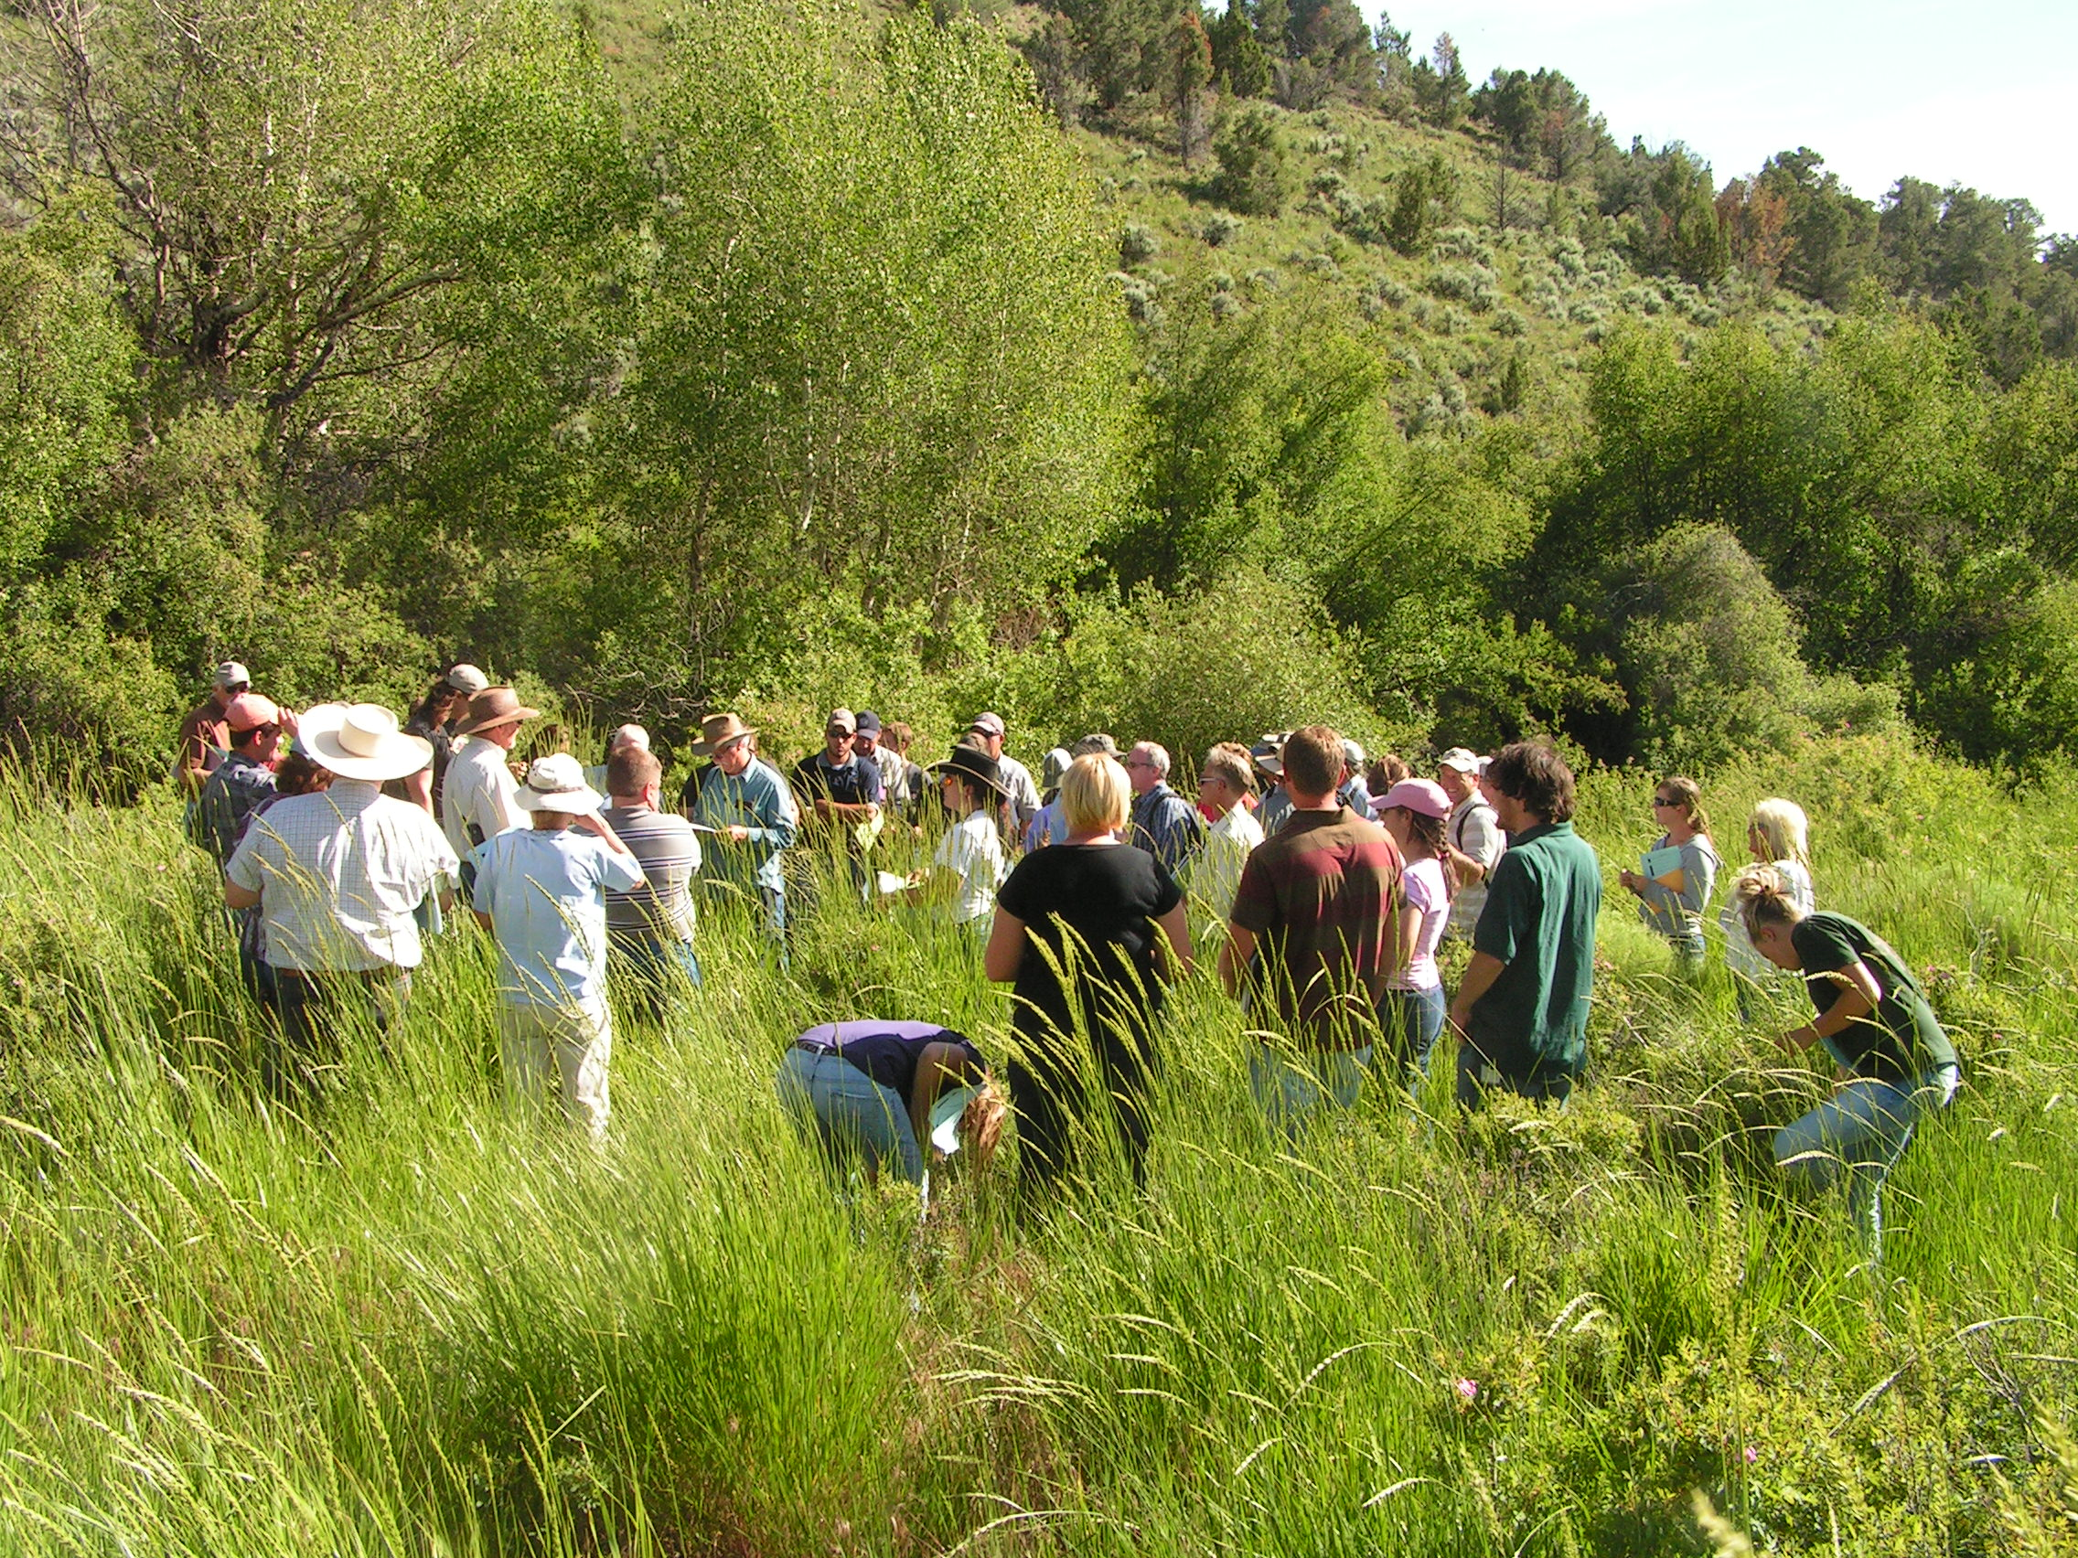
Classes planned for 20010
Squaw Valley Ranch
Carson City
Jiggs
Owyhee
Eureka (PFC and Grazing Management/Monitoring)
Collaborations planned
Ruby Mountains
South Fork of the Humboldt River

