Slide 1
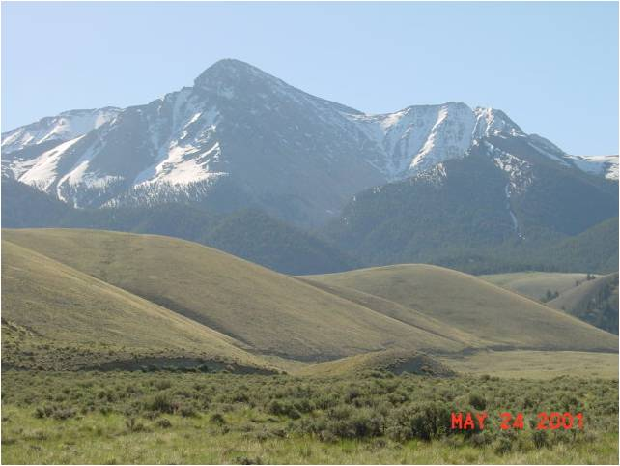
Idaho Riparian Cadre
Summary of 2008 – 2009

Slide 2
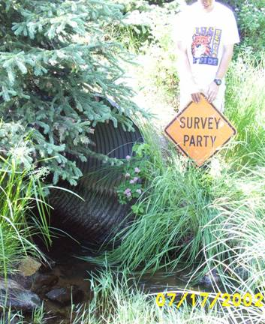
Idaho Team Members
Bryce Bohn – BLM cadre lead
Dan Kotanski – BLM hydrologist
Arn Berglund – BLM fish biologist
Meribeth Lumpkin – IDL Lands Specialist
Erv Cowley – Riparian specialist consultant
Tim Burton – Fish biologist consultant
Walt Poole – IDFG biologist
Nika Lepak – BLM range specialist
Gina Rone – FS soil scientist
Scott Hoefer – BLM fish biologist
Paul Drury – Water engineering consultant
Melanie Vining – FS hydrologist

Slide 3
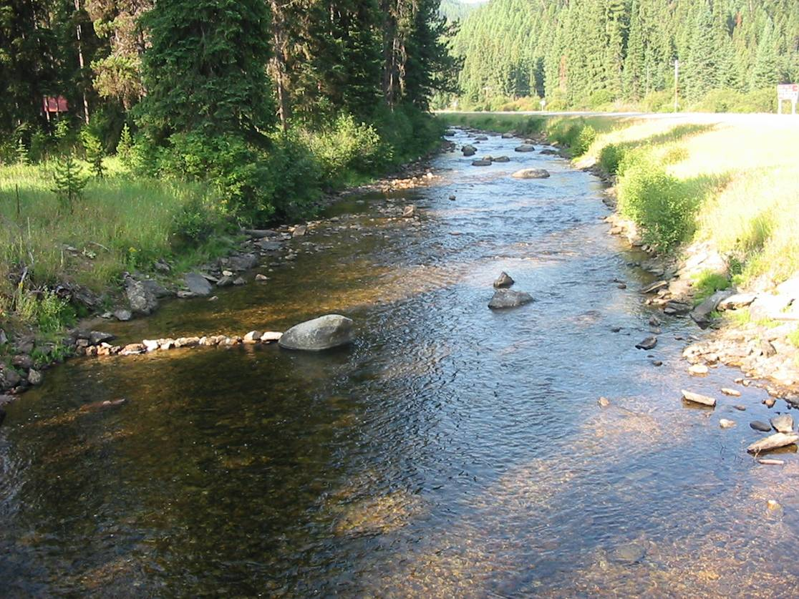
2008 Highlights
PFC and stratification for monitoring
  Salmon, ID
  60 people
University of Idaho PFC overview
  Karen Launchbaugh – Range monitoring
  30 undergrad and grad students
MIM training (FS/BLM)
  Challis, ID
  20 people

Slide 4
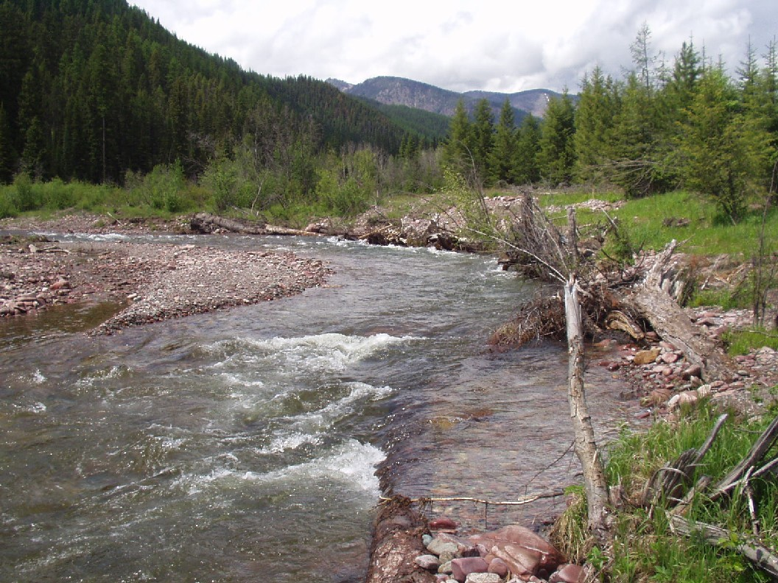
2009 Highlights
Steve and Tim bail within weeks of Bryce’s arrival. Bryce finds out that he is now the cadre leader. He spent 2009 learning what exactly that means.
Lentic PFC training
  Challis, ID
  17 participants
Lotic PFC training
  Shoshone, ID
  23 participants
MIM overview training (Jarbidge and Shoshone field offices)
  Shoshone, ID
  32 participants

Slide 5
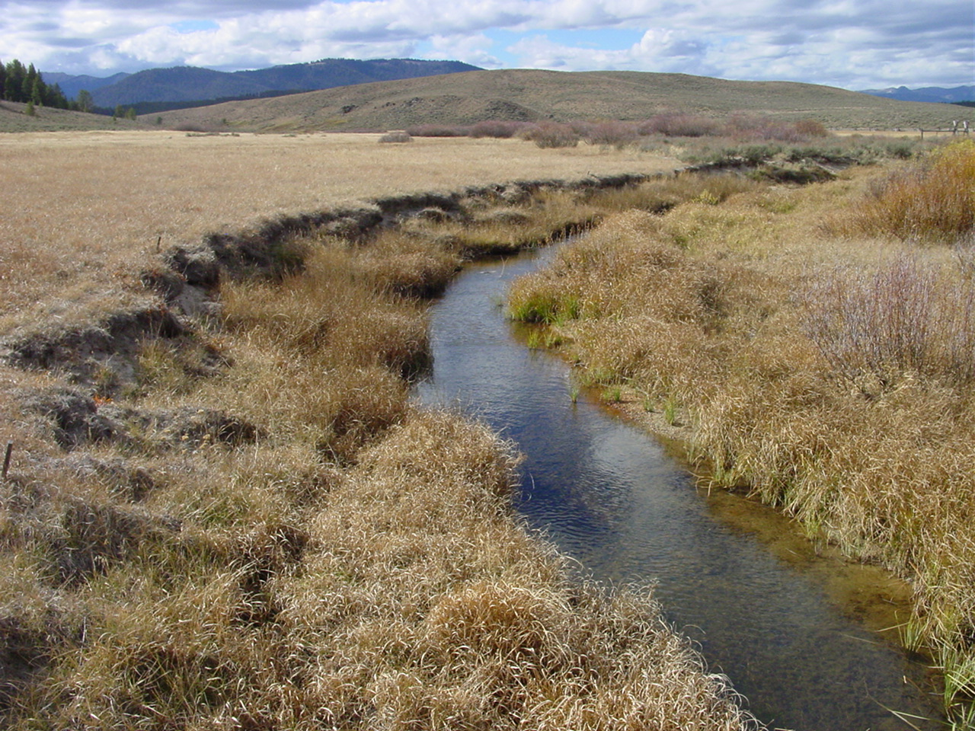
2009 Highlights
Recruited 5 new members to the state cadre team.
  3 BLM members
  2 FS members
Prepared and distributed a flyer announcing the services that the Idaho cadre are prepared to provide.

Slide 6
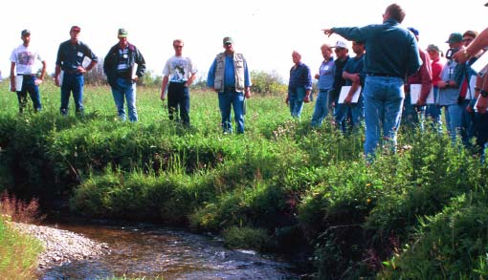
2010 Program
Begin baseline inventory of the riparian resources in the Owyhee NLCS.
Wetland mapping of the Owyhee NLCS with the FWS.
Develop state-wide riparian inventory and monitoring IDIQ for use by field offices.
Shoshone FO has a prototype PDA version of the PFC that will be field tested.
MIM training on Jarbidge field office.
Univ. of Idaho rangeland monitoring course.
Oregon/Idaho PFC training.
Willing to volunteer to begin migrating legacy PFC data into new national riparian database.
Begin to insert new cadre members into trainings.

Slide 7

Questions

